Slide 1


Modern Operating Systems
Fifth Edition
Chapter 5
Input /Output
Copyright © 2023, 2014, 2008 Pearson Education, Inc. All Rights Reserved
Notes:
If this PowerPoint presentation contains mathematical equations, you may need to check that your computer has the following installed:
1) Math Type Plugin
2) Math Player (free versions available)
3) NVDA Reader (free versions available)

Slide 2
Overview (1 of 4)
Principles of I/O Hardware
Principles of I/O Software
I/O Devices

Slide 3
Overview (2 of 4)
Principles of I/O Hardware
Principles of I/O Software
I/O Devices

Slide 4
I/O Devices (1)
Block devices (e.g., hard disks and S S D s)
Stores information in fixed-size blocks
Transfers are in units of entire blocks
I/O occurs with random access (by block I D)
Character devices (e.g., printers, network interfaces)
No blocks, only stream of characters (or bytes)
Not addressable, does not have any seek operation
I/O occurs with sequential access
Distinction is a bit blurred
Is a tape drive a block or a character device?
Some devices do not fit in this model, e.g. clocks

Slide 5
I/O Devices (2)
Device | Data rate
Keyboard | 10 bytes/s e c
Mouse | 100 bytes/s e c
56K modem | 7 K B/s e c
Bluetooth 5 B L E | 256 K B/s e c
Scanner at 300 d p i | 1 M B/s e c
Digital video recorder | 3.5 M B/s e c
802.11n Wireless | 37.5 M B/s e c
U S B 2.0 | 60 M B/s e c
16x Blu-ray disc | 72 M B/s e c
Gigabit Ethernet | 125 M B/s e c
S A T A 3 disk drive | 600 M B/s e c
U S B 3.0 | 625 M B/s e c
Single-lane P C I e 3.0 bus | 985 M B/s e c
802.11 a x Wireless | 1.25 G B/s e c
P C I e Gen 3.0 N V M e M.2 S S D (reading) | 3.5 G B/s e c
U S B 4.0 | 5 G B/s e c
P C I Express 6.0 | 126 G B/s e c
Figure 5.1 Some typical device, network, and bus data rates.

Slide 6
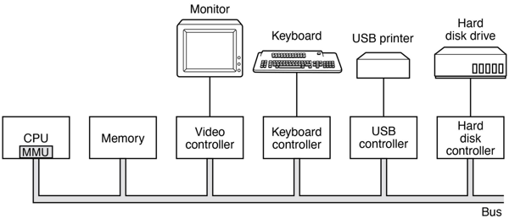
Device Controller
Located between actual device and computer
Offers electronic interface in form of I/O registers
R/W those registers to ask the controller to perform actions
Notes:
Long Description:
In the illustration, starting from the left, a C P U or M M U, a memory, a video controller, a keyboard controller, a U S B controlled, and a hard disk controller is all connected parallelly from left to right in a bus bar. The video controller is connected to a monitor separately from above. Likewise, the keyboard controller is connected to a keyboard, the U S B controller is connected to a U S B printer, and the hard disk controller is connected to a hard disk drive.

Slide 7
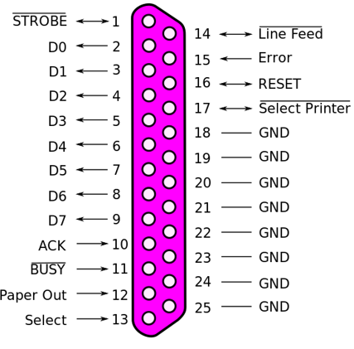
Example: Parallel Port
Notes:
Long Description:
The illustration shows the pin number and signals name as follows. 1, STROBE; 2, D 0; 3, D 1; 4, D 2; 5, D 3; 6, D 4; 7, D 5; 8, D 6; 9, D 7; 10, A C K; 11, BUSY; 12, Paper out; 13, select; 14, line feed; 15, error; 16, reset; 17, select printer; 18, G N D; 19, G N D; 20, G N D; 21, G N D; 22, G N D; 23, G N D; 24, G N D; 25, G N D.

Slide 8
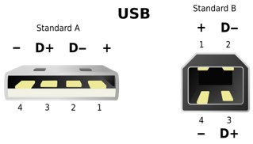
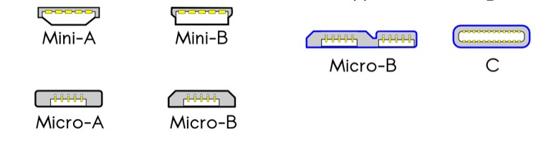
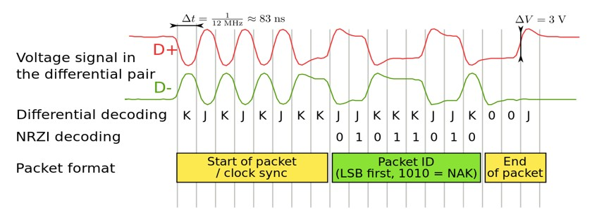
Example: U S B
Pin | Name | Cable color | Description
1 | V C C | Red | +5 V D C
0 | D- | White | Data -
3 | D+ | Green | Data +
4 | G N D | Black | Ground
Petteri Aimonen
Notes:
Long Description1:
The left illustration shows U S B Standard A. The pins are labeled from left to right as follows. Negative, 4; D positive, 3; D negative, 2; positive, 1. The right illustration shows U S B Standard B. The pins are labeled as follows. Positive, 1; D negative, 2; D positive, 3; negative, 4.
Long Description2:
The left side of the illustration shows U S B 1 point 0 dash 2 point 0. The labelings of different types of U S B are as follows. A, B, Mini-A, Mini-B, Micro-A, and Micro-B. The right side of the illustration shows U S B 3 point 0 dash 3 point 1. The labelings of different types of U S B are as follows. Micro-B and C.
Long Description3:
The illustration consists of the following fields. Voltage signal in the differential pair, differential decoding N R Z I decoding, packet format, the start of packet slash clock sync, the packet I D (L S B first, 1010 equals NAK), and end of packet. Voltage signal in the differential pair: a wave labeled D plus is a line becoming a regular sine wave with 3 cycles and becoming an irregular square waveform for two cycles and a line. The wavelength is delta t equals 1 over 12 M H z approximately equals 83 m s. Differential decoding N R Z I decoding: a wave labeled D minus is a line becoming a regular sine wave with 3 cycles and thereafter following the reverse trend of the wave of the voltage signal in the differential pair. Differential decoding: K; J; K; J; K; J; K; K; J; J; K; K; K; J; J; K; 0; 0; J. N R Z I decoding: blank; blank; blank; blank; blank; blank; blank; blank; 0; 1; 0; 1; 1; 0; 1; 0. Start of packet is till K; K of differential decoding, Packet I D is till J; J; K, and End of packet is 0 0 J.

Slide 9
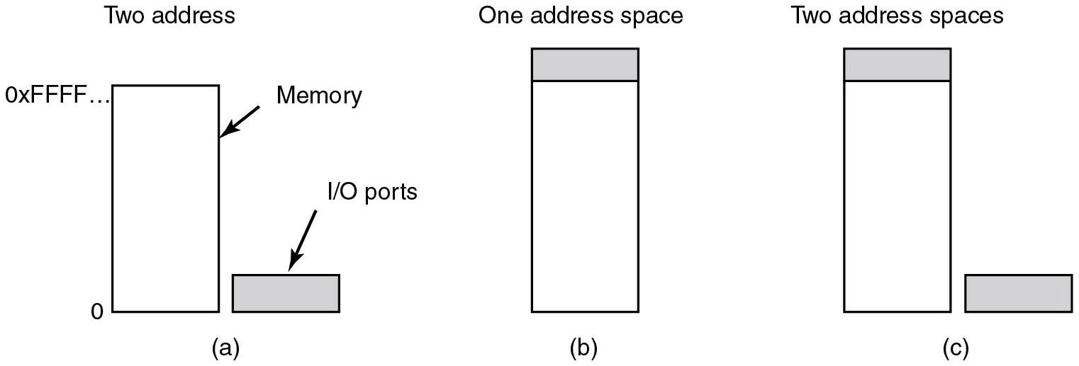
Accessing I/O Registers (1 of 3)
Port-mapped I/O (P M I O)
I/O Registers are accessed via dedicated port numbers and special instructions
inb a x, 0x278 hash load value of I/O register
hash 0x278 to register a x
Figure 5.2 (a) Separate I/O and memory space.

Slide 10
Accessing I/O Registers (2 of 3)
Memory-mapped I/O (M M I O)
I/O Registers are mapped into addresses of main memory and accessed like memory
mov 0x278, a x hash store value of a x
hash to address 0x278
Figure 5.2 (b) Memory-mapped I/O.

Slide 11
Accessing I/O Registers (3 of 3)
Hybrid (P M M I O + M M I O)
Both implementation can coexist on a given architecture
Example: x86
Figure 5.2 (c) Hybrid.

Slide 12
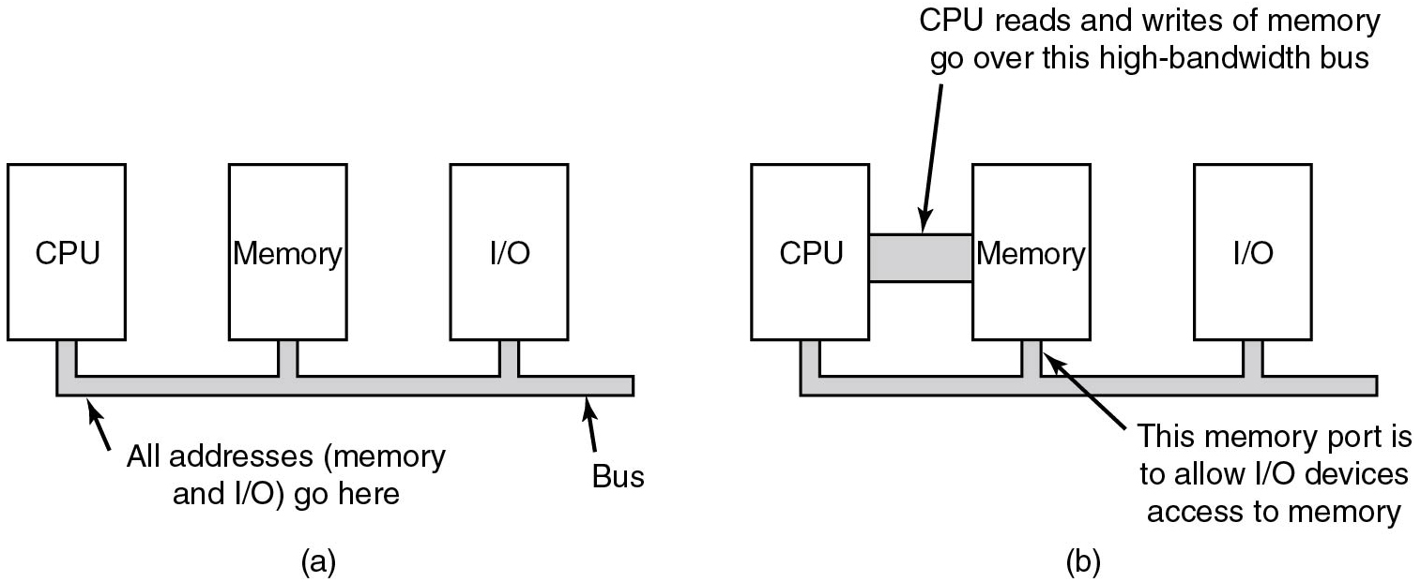
Memory-Mapped I/O
Figure 5.3 (a) A single-bus architecture. (b) A dual-bus memory architecture.
Notes:
Long Description:
Figure a: The blocks labeled C P U, Memory, and I slash O are arranged from left to right. Connection lines labeled all addresses (memory and I slash O) go here, from the bottom of each line are connected to a bus.
Figure b: The blocks labeled C P U, Memory, and I slash O are arranged from left to right and connected from the bottom to a bus. Here the C P U block and memory block is connected by a bus which is labeled C P U reads and writes of memory go over this high bandwidth bus. The text labeled This memory port is to allow I slash O devices access to memory points to the memory block.

Slide 13
P M I O Example (I B M P C)
Port range | Summary
0x0000-0x001F | The first legacy DMA controller, often used for transfers to floppies.
0x0020-0x0021 | The first Programmable Interrupt Controller
0x0040-0x0047 | The P I T (Programmable Interval Timer)
0x0060-0x0064 | The "8042" PS/2 Controller or its predecessors, dealing with keyboards and mice.
0x0070-0x0071 | The C M O S and RTC registers
0x0080-0x008F | The D M A (Page registers)
0x0092 | The location of the fast A20 gate register
0x00A0-0x00A1 | The second P I C
0x00C0-0x00D F | The second D M A controller, often used for sound blasters
0x0170-0x0177 | The secondary A T A hard disk controller.
0x01F0-0x01F7 | The primary A T A hard disk controller.
0x0278-0x027A | Parallel port
0x02F8-0x02FF | Second parallel port
0x03B0-0x03D F | The range used for the I B M V G A, its direct predecessors, as well as any modern video card in legacy mode.
0x03F0-0x03F7 | Floppy disk controller
0x03F8-0x03F F | First serial port
Notes:
Ken Thompson and Dennis Ritchie developed a simpler O S which they called UNICS (later: UNIX). Many students studied it, especially when John Lions published a line-by-line commentary of the source code. This comment is found in the source. It has become famous.
Image 1 from: https://cdn1.vogel.de/unsafe/fit-in/1000x0/images.vogel.de/vogelonline/bdb/1717400/1717458/original.jpg
Image 2 from: https://upload.wikimedia.org/wikipedia/commons/thumb/5/50/Lions_Commentary_Unix.jpeg/330px-Lions_Commentary_Unix.jpeg

Slide 14
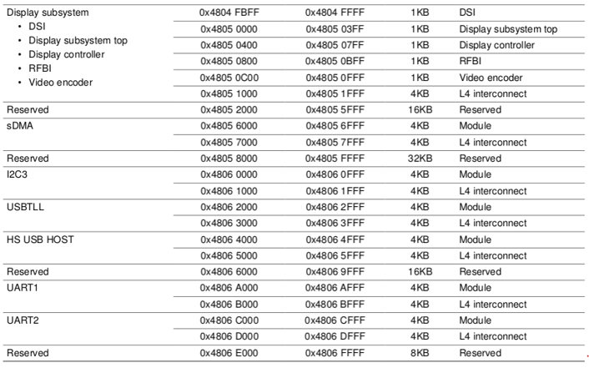
M M I O Example (O M A P 3)
Notes:
Ken Thompson and Dennis Ritchie developed a simpler OS which they called UNICS (later: UNIX). Many students studied it, especially when John Lions published a line-by-line commentary of the source code. This comment is found in the source. It has become famous.
Image 1 from: https://cdn1.vogel.de/unsafe/fit-in/1000x0/images.vogel.de/vogelonline/bdb/1717400/1717458/original.jpg
Image 2 from: https://upload.wikimedia.org/wikipedia/commons/thumb/5/50/Lions_Commentary_Unix.jpeg/330px-Lions_Commentary_Unix.jpeg
Long Description:
The table has 5 columns and 11 rows. The data are as follows: Row 1 is divided into 6 subrows. Row 1: Display subsystem; 0 times 4804 F B F F; 0 times 4804 F F F F; 1 K B; D S I. The subrows are as follows: Subrow 1: D S I; 0 times 4805 0000; 0 times 4805 03 F F; 1 K B; Display subsystem top. Subrow 2: Display subsystem top; 0 times 4805 0400; 0 times 4805 07 F F; 1 K B; Display controller. Subrow 3: Display controller; 0 times 4805 0800; 0 times 4805 0 B F F; 1 K B; R F B I. Subrow 4: R F B I; 0 times 4805 0 C 00; 0 times 4805 0 F F F; 1 K B; Video encoder. Subrow 5: Video encoder; 0 times 4805 1000; 0 times 4805 1 F F F; 4 K B; L 4 interconnect. Row 2: Reserved; 0 times 4805 2000; 0 times 4805 5 F F F F; 16 K B; Reserved. Row 2: Reserved; 0 times 4805 2000; 0 times 4805 5 F F F F; 16 K B; Reserved. Row 3 is divided into two subrows. Row 3 subrow 1: s D M A; 0 times 4805 6000; 0 times 4805 6 F F F; 4 K B; Module. Row 3 subrow 2: blank; 0 times 4805 7000; 0 times 4805 7 F F F; 4 K B; L 4 interconnect. Row 4: Reserved; 0 times 4805 8000; 0 times 4805 F F F F; 32 K B; Reserved. Row 5 has two subrows. Row 5 subrow 1: I 2 C 3; 0 times 4806 0000; 0 times 4806 0 F F F; 4 K B; Module. Row 6 subrow 2: blank; 0 times 4806 1000; 0 times 4806 1 F F F; 4 K B; L 4 interconnect. Rows 7 and 8 also have two subrows each. Row 7 subrow 1: U S B T L L; 0 times 4806 2000; 0 times 4806 2 F F F; 4 K B; Module. Row 7 subrow 2: blank; 0 times 4806 3000; 0 times 4806 3 F F F; 4 K B; L 4 interconnect. Row 8 subrow 1: H S U S B HOST; 0 times 4806 4000; 0 times 4806 4 F F F; 4 K B; Module. Row 8 subrow 2: blank; 0 times 4806 5000; 0 times 4806 5 F F F; 4 K B; L 4 interconnect. Row 9: Reserved; 0 times 4806 6000; 0 times 4806 9 F F F; 16 K B; Reserved. Rows 10 and 11 have two subrows each. Row 10 subrow 1: UART 1; 0 times 4806 A 000; 0 times 4806 A F F F; 4 K B; Module. Row 10 subrow 2: blank; 0 times 4806 B 000; 0 times 4806 B F F F; 4 K B; L 4 interconnect. Row 11 subrow 1: UART 2; 0 times 4806 C 000; 0 times 4806 C F F F; 4 K B; Module. Row 11 subrow 2: blank; 0 times 4806 D 000; 0 times 4806 D F F F; 4 K B; L 4 interconnect. Row 12: Reserved; 0 times 4806 E 000; 0 times 4806 F F F F; 8 K B; Reserved.

Slide 15
Quiz (1 of 3)
What mechanism (P M I O versus. M M I O) is more flexible and efficient to implement device access control for unprivileged user processes?

Slide 16
Answer to Quiz (1 of 3)
Q: What mechanism (P M I O versus. M M I O) is more flexible and efficient to implement device access control for unprivileged user processes?
A: M M I O because mapping a page containing I/O ports can be handled by the normal virtual memory system. To allow a user access to a device, just map its control page into the user’s address space

Slide 17
Waiting for I/O Requests Ellipsis
We can now send commands to devices, but what if the requested operation takes time?
Most devices offer status bits in their registers to signal that a request has been finished (and the error code)
O S can poll this status bit (polling)
Is this a good solution?
Notes:
Long Description:
Part (a): It is labeled as a three-stage pipeline. There are three blocks connected with each other with a forward arrow. The first block is labeled Fetch unit, the second block is labeled Decode unit and the third block is labeled Execute unit. Part (b): It is labeled as Superscalar C P U. There are seven square-shaped blocks and an ellipse-shaped block at the center of the square-shaped blocks. The first two top blocks are labeled as Fetch unit and Decode unit. Similarly, the bottom two blocks are labeled as Fetch unit and Decode unit. In the center, the ellipse-shaped block is labeled Holding buffer. Both Fetch units are connected to both Decode units with arrows and similarly, both decode units are connected with Holding buffer with the forward arrows. The Holding buffer is connected with the other three blocks labeled Execute unit placed on the right of the Holding buffer block.

Slide 18
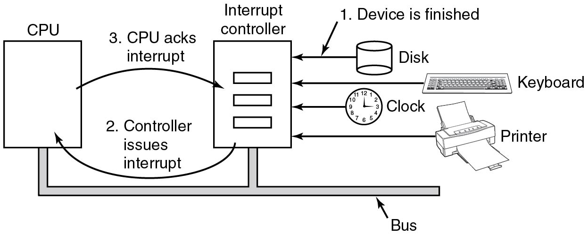
Interrupts (1)
Device controller can trigger interrupts to signal that a I/O request is complete
For the device, this means simply changing the voltage on an electrical interrupt line
Each controller has interrupt vector assigned
C P U runs vector-specific handler when int occurs
Figure 5.4. Operation of a D M A transfer.
Notes:
Long Description:
The diagram has the blocks labeled C P U and interrupt controller and transfer devices. C P U and interrupt controller are connected in parallel in a bus bar. A forward arrow labeled 3. C P U acks interrupt is from C P U to interrupt controller. A reverse arrow labeled 2. Controller issues interrupt is from interrupt controller to C P U. Left arrows are from disk, keyboard, clock, and printer to interrupt controller. The left arrow from disk is labeled 1. Device is finished.

Slide 19
Interrupts (2)
Different terminology used to describe interrupts
Trap: deliberate action from a program
Fault (exception): usually not deliberate
Hardware interrupt: device such as printer or network sends a signal to the C P U
Interrupts can be precise or imprecise
Notes:
Long Description:
Part (a): It is labeled as a three-stage pipeline. There are three blocks connected with each other with a forward arrow. The first block is labeled Fetch unit, the second block is labeled Decode unit and the third block is labeled Execute unit. Part (b): It is labeled as Superscalar C P U. There are seven square-shaped blocks and an ellipse-shaped block at the center of the square-shaped blocks. The first two top blocks are labeled as Fetch unit and Decode unit. Similarly, the bottom two blocks are labeled as Fetch unit and Decode unit. In the center, the ellipse-shaped block is labeled Holding buffer. Both Fetch units are connected to both Decode units with arrows and similarly, both decode units are connected with Holding buffer with the forward arrows. The Holding buffer is connected with the other three blocks labeled Execute unit placed on the right of the Holding buffer block.

Slide 20
Precise Interrupt
Four properties of a precise interrupt:
The P C saved in a known place
All instructions before that pointed to by P C have fully executed
No instruction beyond that pointed to by P C has been executed
Execution state of instruction pointed to by P C is known
Notes:
Long Description:
Part (a): It is labeled as a three-stage pipeline. There are three blocks connected with each other with a forward arrow. The first block is labeled Fetch unit, the second block is labeled Decode unit and the third block is labeled Execute unit. Part (b): It is labeled as Superscalar C P U. There are seven square-shaped blocks and an ellipse-shaped block at the center of the square-shaped blocks. The first two top blocks are labeled as Fetch unit and Decode unit. Similarly, the bottom two blocks are labeled as Fetch unit and Decode unit. In the center, the ellipse-shaped block is labeled Holding buffer. Both Fetch units are connected to both Decode units with arrows and similarly, both decode units are connected with Holding buffer with the forward arrows. The Holding buffer is connected with the other three blocks labeled Execute unit placed on the right of the Holding buffer block.

Slide 21
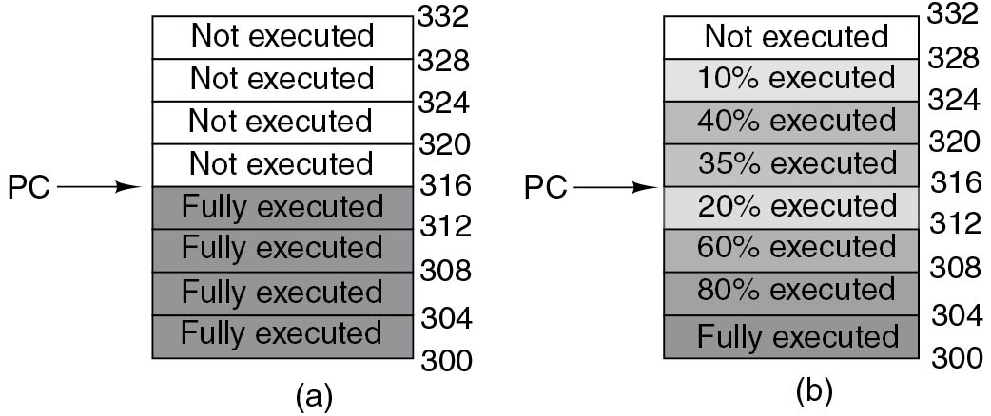
Precise versus. Imprecise
Figure 5.6 (a) A precise interrupt. (b) An imprecise interrupt.
Notes:
Long Description:
Two stacks containing eight rows are shown here. It is numbered from bottom to top as follows. 300, 304, 308, 312, 316, 320, 324, 328, 332.
Figure a: Here the first four rows from the bottom are labeled fully executed and shaded, and the remaining four rows are labeled not executed. An arrow labeled P C points to row 316.
Figure b: Here the rows from bottom to top are given as follows. Fully executed, 80 percent executed, 60 percent executed, 20 percent executed, 35 percent executed, 40 percent executed, 10 percent executed, not executed. An arrow labeled P C points to row 316.

Slide 22
Data Exchange Between Device and C P U (1 of 2)
How do we transfer data from e.g., hard disk to memory?
Program disk controller to read a sector
Wait for interrupt
Read sizeof(sector) bytes from I/O registers
Repeat for next sector
Is this a problem?
Notes:
Long Description:
Part (a): It is labeled as a three-stage pipeline. There are three blocks connected with each other with a forward arrow. The first block is labeled Fetch unit, the second block is labeled Decode unit and the third block is labeled Execute unit. Part (b): It is labeled as Superscalar C P U. There are seven square-shaped blocks and an ellipse-shaped block at the center of the square-shaped blocks. The first two top blocks are labeled as Fetch unit and Decode unit. Similarly, the bottom two blocks are labeled as Fetch unit and Decode unit. In the center, the ellipse-shaped block is labeled Holding buffer. Both Fetch units are connected to both Decode units with arrows and similarly, both decode units are connected with Holding buffer with the forward arrows. The Holding buffer is connected with the other three blocks labeled Execute unit placed on the right of the Holding buffer block.

Slide 23
Data Exchange Between Device and C P U (2 of 2)
How do we transfer data from e.g., hard disk to memory?
Program disk controller to read a sector
Wait for interrupt
Read sizeof(sector) bytes from I/O registers
Repeat for next sector
Is this a problem?
Yes! C P U cycles can be spent in a better way!
Notes:
Long Description:
Part (a): It is labeled as a three-stage pipeline. There are three blocks connected with each other with a forward arrow. The first block is labeled Fetch unit, the second block is labeled Decode unit and the third block is labeled Execute unit. Part (b): It is labeled as Superscalar C P U. There are seven square-shaped blocks and an ellipse-shaped block at the center of the square-shaped blocks. The first two top blocks are labeled as Fetch unit and Decode unit. Similarly, the bottom two blocks are labeled as Fetch unit and Decode unit. In the center, the ellipse-shaped block is labeled Holding buffer. Both Fetch units are connected to both Decode units with arrows and similarly, both decode units are connected with Holding buffer with the forward arrows. The Holding buffer is connected with the other three blocks labeled Execute unit placed on the right of the Holding buffer block.

Slide 24
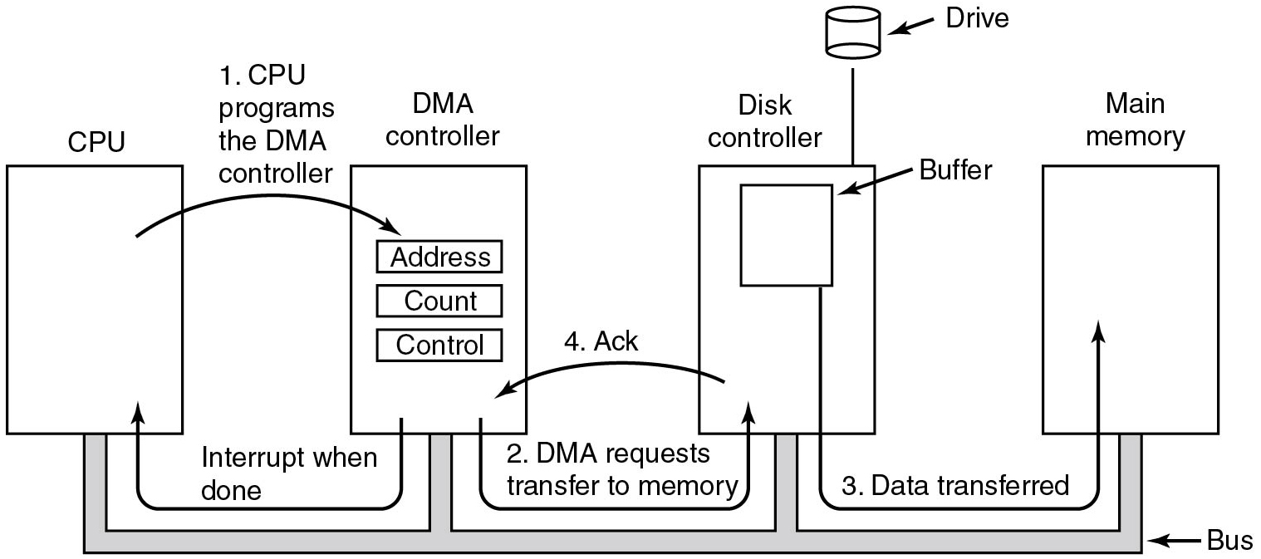
Direct Memory Access (D M A)
Solution:
Let the hardware do the transfer via D M A!
Figure 5.4 Operation of a D M A transfer.
Notes:
Long Description:
The figure consists of four blocks labeled C P U, D M A controller, Disk controller, and main memory connected from the bottom by a bus. The D M A controller block contains three sub-blocks labeled address, count, and control. An arrow labeled 1, C P U programs the D M A controller from C P U block points to the D M A controller block. Another arrow labeled 2, D M A requests transfer to memory points from D M A controller to the disk controller block. The disk controller contains a block labeled buffer which is connected to the main memory block using an arrow labeled 3, data transfer. A drive is also attached to the disk controller. An arrow from the disk controller points to the D M A controller labeled 4, Ack. Another arrow from the D M A controller points to the C P U labeled interrupt when done.

Slide 25
D M A Controller (1 of 2)
On I S A systems there was a dedicated D M A controller (third-party D M A)
On P C I (and P C I e) systems each P C I device may become “Bus Master” and perform D M A (first-party D M A)
Device and D M A controller are combined
Do you see a problem here?
Notes:
Long Description:
Part (a): It is labeled as a three-stage pipeline. There are three blocks connected with each other with a forward arrow. The first block is labeled Fetch unit, the second block is labeled Decode unit and the third block is labeled Execute unit. Part (b): It is labeled as Superscalar C P U. There are seven square-shaped blocks and an ellipse-shaped block at the center of the square-shaped blocks. The first two top blocks are labeled as Fetch unit and Decode unit. Similarly, the bottom two blocks are labeled as Fetch unit and Decode unit. In the center, the ellipse-shaped block is labeled Holding buffer. Both Fetch units are connected to both Decode units with arrows and similarly, both decode units are connected with Holding buffer with the forward arrows. The Holding buffer is connected with the other three blocks labeled Execute unit placed on the right of the Holding buffer block.

Slide 26
D M A Controller (2 of 2)
On I S A systems there was a dedicated D M A controller (third-party D M A)
On P C I (and P C I e) systems each P C I device may become “Bus Master” and perform D M A (first-party D M A)
Device and D M A controller are combined
Do you see a problem here?
You have to trust your H W (or use a I/O M M U)
Note:
Embedded systems still have dedicated D M A controller
Disk controller still uses own buffers
Notes:
Long Description:
Part (a): It is labeled as a three-stage pipeline. There are three blocks connected with each other with a forward arrow. The first block is labeled Fetch unit, the second block is labeled Decode unit and the third block is labeled Execute unit. Part (b): It is labeled as Superscalar C P U. There are seven square-shaped blocks and an ellipse-shaped block at the center of the square-shaped blocks. The first two top blocks are labeled as Fetch unit and Decode unit. Similarly, the bottom two blocks are labeled as Fetch unit and Decode unit. In the center, the ellipse-shaped block is labeled Holding buffer. Both Fetch units are connected to both Decode units with arrows and similarly, both decode units are connected with Holding buffer with the forward arrows. The Holding buffer is connected with the other three blocks labeled Execute unit placed on the right of the Holding buffer block.

Slide 27
Quiz (2 of 3)
You’re comparing the performance of two systems, both using no interrupts for device data transfer, but one using D M A + polling while the other system uses polling alone.
Do you expect comparable or different performance for the two systems?

Slide 28
Answer to Quiz (2 of 3)
You’re comparing the performance of two systems, both using no interrupts for device data transfer, but one using D M A + polling while the other system uses polling alone.
Q: Do you expect comparable or different performance for the two systems?
A: When D M A is used, the C P U can possibly do other work while the I/O is going on.

Slide 29
Overview (3 of 4)
Principles of I/O Hardware
Principles of I/O Software
I/O Devices
Notes:
Long Description:
The image consists of two parts. Part (a): There are four square-shaped blocks labeled Core 1, Core 2, Core 3, and Core 4 placed at each corner inside a bigger square. There is a rectangle-shaped block labeled L2 cache placed between four blocks. All four blocks are connected with L 2 cache. Part (b): There are four square-shaped blocks labeled Core 1, Core 2, Core 3, and Core 4 placed at each corner inside a bigger square. The L 1 cache is placed in all four blocks in the top left corners of the blocks. The L 2 cache is placed in all four blocks in the lower right corners of the blocks. None of the blocks is connected.

Slide 30
Principles of I/O Software (1 of 3)
Issues:
Device independence
Uniform naming
Error handling
Buffering
Synchronous versus asynchronous
Notes:
Long Description:
The image consists of two parts. Part (a): There are four square-shaped blocks labeled Core 1, Core 2, Core 3, and Core 4 placed at each corner inside a bigger square. There is a rectangle-shaped block labeled L2 cache placed between four blocks. All four blocks are connected with L 2 cache. Part (b): There are four square-shaped blocks labeled Core 1, Core 2, Core 3, and Core 4 placed at each corner inside a bigger square. The L 1 cache is placed in all four blocks in the top left corners of the blocks. The L 2 cache is placed in all four blocks in the lower right corners of the blocks. None of the blocks is connected.

Slide 31
Principles of I/O Software (2 of 3)
Device independence
I/O software provides abstraction over actual hardware
Programs should not have to care about device particularities
Uniform naming
We don’t want to type S T6N M04 to address the first hard disk
/dev/sda is better
/mnt/movies even better
Error handling
Errors should be handled closest to their source
Notes:
Long Description:
The image consists of two parts. Part (a): There are four square-shaped blocks labeled Core 1, Core 2, Core 3, and Core 4 placed at each corner inside a bigger square. There is a rectangle-shaped block labeled L2 cache placed between four blocks. All four blocks are connected with L 2 cache. Part (b): There are four square-shaped blocks labeled Core 1, Core 2, Core 3, and Core 4 placed at each corner inside a bigger square. The L 1 cache is placed in all four blocks in the top left corners of the blocks. The L 2 cache is placed in all four blocks in the lower right corners of the blocks. None of the blocks is connected.

Slide 32
Principles of I/O Software (3 of 3)
Buffering
Networking: incoming packets have to be buffered
Audio: buffering to avoid clicks
Synchronous versus. asynchronous I/O
Programs don’t want to deal with interrupts
O S
turns async operations into blocking operations
Lower levels have to deal with interrupts, D M A, etc.

Slide 33
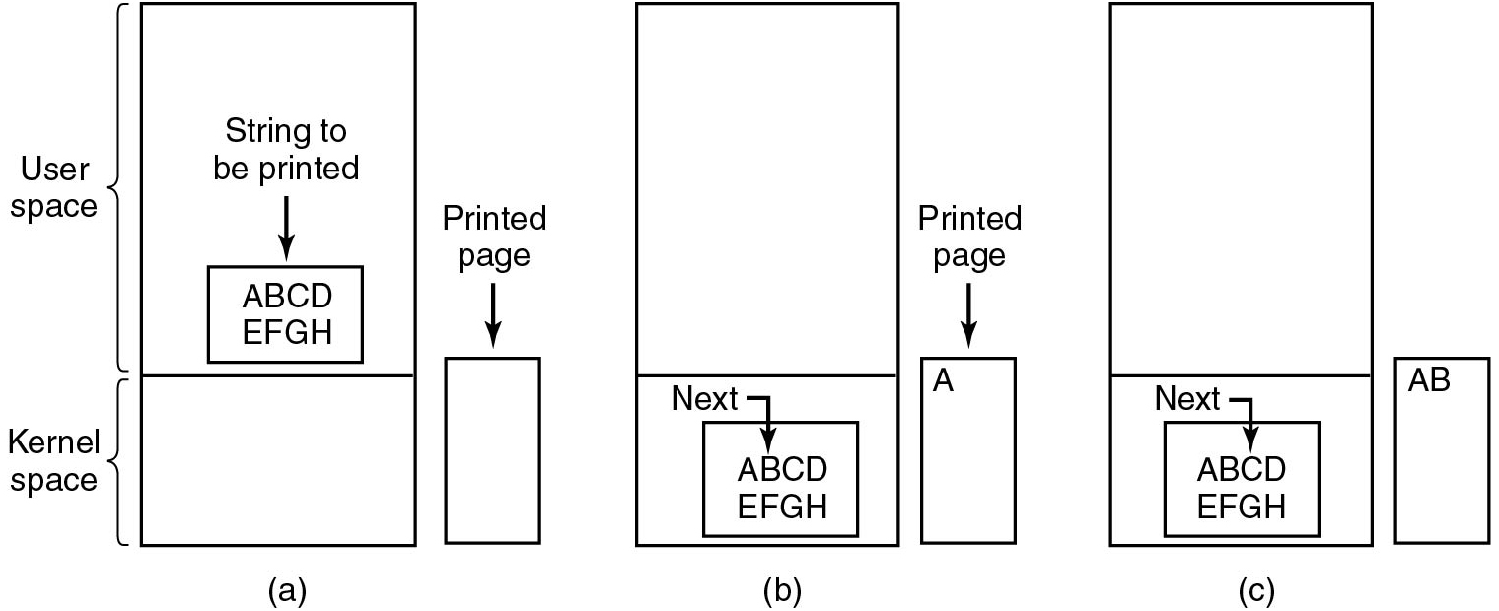
Programmed I/O (1)
Figure 5.7 Steps in printing a string.
Notes:
Long Description:
Figure a: It shows a block divided into two segments, the larger top segment is labeled user space and the smaller bottom space is labeled kernel space. The user space segment consists of a sub-block labeled A B C D E F G H which represents the string to be printed. Another block labeled printed page is shown next to the main block.
Figure b: It shows the same block but the sub-block labeled A B C D E F G H is given inside the kernel space and an arrow labeled next is pointed to the alphabet B. The printed page block consists of the alphabet A.
Figure c: Here the arrow next is pointed to the alphabet C given inside the sub-block. The printed page consists of the alphabet A B printed on it.

Slide 34
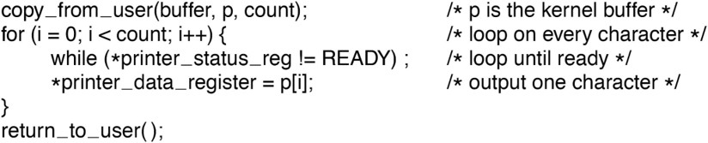
Programmed I/O (2)
Figure 5.8 Writing a string to the printer using programmed I/O.
Notes:
Long Description:
The 6 lines of code are as follow
copy underscore from underscore user open parenthesis buffer comma p comma count close parenthesis semicolon forward slash asterisk p is the kernel buffer asterisk forward slash
for open parenthesis i equals to 0 semicolon i less than count semicolon i plus plus close parenthesis open curly bracket forward slash asterisk loop on every character asterisk forward slash
while open parenthesis asterisk printer underscore status underscore reg exclamation equals to READY close parenthesis semicolon forward slash asterisk loop until ready asterisk forward slash
asterisk printer underscore data underscore register equals to p open box bracket i close box bracket semicolon forward slash asterisk output one character asterisk forward slash
close curly bracket
return underscore to underscore user open close parenthesis semicolon

Slide 35
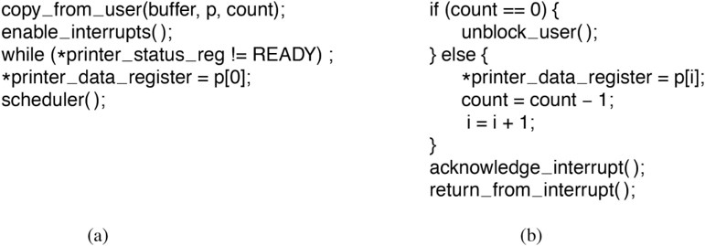
Interrupt-Driven I/O
Figure 5.9 Writing a string to the printer using interrupt-driven I/O. (a) Code executed at the time the print system call is made. (b) Interrupt service procedure for the printer.
Notes:
Long Description:
The 5 lines of code for figure (a) are as follows
copy underscore from underscore user open parenthesis buffer comma p comma count close parenthesis semicolon
enable underscore interrupts open close parenthesis semicolon
while open parenthesis asterisk printer underscore status underscore reg exclamation equals to READY close parenthesis semicolon
asterisk printer underscore data underscore register equals to p open box bracket 0 close box bracket semicolon
scheduler open close parenthesis semicolon
The 9 lines of code for figure (b) are as follow
if open parenthesis count equals to equals to 0 close parenthesis open curly bracket
unblock underscore user open close parenthesis semicolon
close curly bracket else open curly bracket
asterisk printer underscore data underscore register equals to p open box bracket i close box bracket
count equals to count minus 1 semicolon
i equals to i plus 1 semicolon
close curly bracket
acknowledge underscore interrupt open close parenthesis semicolon
return underscore from underscore interrupt open close parenthesis semicolon

Slide 36
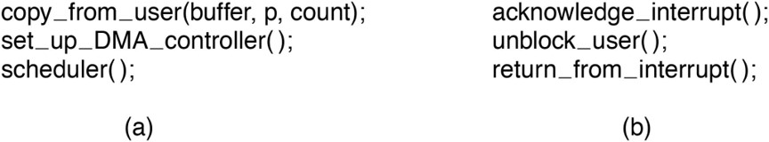
I/O Using D M A
Figure 5.10 Printing a string using D M A.
(a) Code executed when the print system call is made.
(b) Interrupt service procedure.
Notes:
Long Description:
The 3 lines of code for figure (a) are as follows.
copy underscore from underscore user open parenthesis buffer comma p comma count close parenthesis semicolon
set underscore up underscore D M A underscore controller open close parenthesis semicolon
scheduler open close parenthesis semicolon
The 3 lines of code for figure (b) are as follows
acknowledge underscore interrupt open close parenthesis colon
unblock underscore user open close parenthesis semicolon
return underscore from underscore interrupt open close parenthesis semicolon

Slide 37
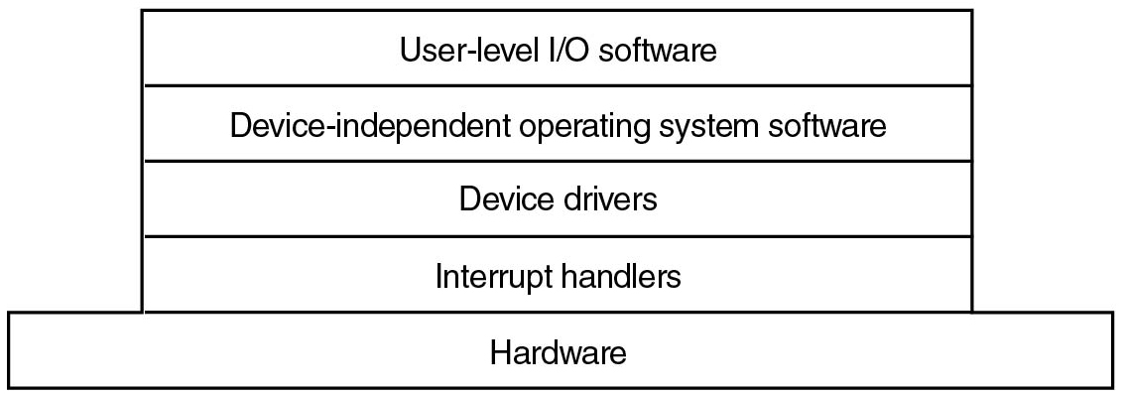
I/O Software Layers
Figure 5.11 Layers of the I/O software system.
Notes:
Long Description:
The figure consists of a block that is placed on another block labeled hardware. The first block is divided into four segments labeled from top to bottom as use level I O software, device-independent operating system software, device drivers, and interrupt handlers.

Slide 38
Interrupt Handlers (1)
Typical steps after hardware interrupt completes:
Save registers (including the P S W) not already saved by interrupt H W
Set up context for interrupt service procedure
Set up a stack for the interrupt service procedure
Acknowledge interrupt controller. If no centralized interrupt controller, re-enable interrupts
Copy registers from where saved to process table
Notes:
Long Description:
There are rectangular blocks placed one above the other labeled Registers, Cache, Main memory, and Magnetic disk / S S D from top to bottom. The smallest block labeled Registers is at the top. There are two types of information labeled Typical access time on the upper left and Typical capacity on the upper right. Part 1. On the left: less than 1 nanosecond. On the right: less than 1 Kilobytes. On the left: 1 to 8 nanoseconds. On the right: 4 to 8 Megabytes. On the left: 10 to 50 nanoseconds. On the right: 16 to 64 gigabytes. On the left: 10 milliseconds backslash 10 seconds to 100 micro seconds. On the right: 2 to 16 plus terabytes. The 16 to 64 gigabytes and 2 to 16 plus terabytes are categorized as optional persistent memory.

Slide 39
Interrupt Handlers (2)
Typical steps after hardware interrupt completes:
Run interrupt service procedure. Typically, extract information from interrupting device controller’s registers. Often split into low-level interrupt service procedure (ran immediately) and high-level interrupt service procedure (scheduled later)
Choose which process to run next
Set up the M M U context for process to run next
Load new process’ registers, including its P S W
Start running the new process
Notes:
Long Description:
There are rectangular blocks placed one above the other labeled Registers, Cache, Main memory, and Magnetic disk / SSD from top to bottom. The smallest block labeled Registers is at the top. There are two types of information labeled Typical access time on the upper left and Typical capacity on the upper right. Part 1. On the left: less than 1 nanosecond. On the right: less than 1 Kilobytes. On the left: 1 to 8 nanoseconds. On the right: 4 to 8 Megabytes. On the left: 10 to 50 nanoseconds. On the right: 16 to 64 gigabytes. On the left: 10 milliseconds backslash 10 seconds to 100 micro seconds. On the right: 2 to 16 plus terabytes. The 16 to 64 gigabytes and 2 to 16 plus terabytes are categorized as optional persistent memory.

Slide 40
Device Drivers (1)
Accepts abstract requests from device-independent layer and transforms them into commands for the device
Can queue new requests as necessary
Usually needs to wait for the completion of the request (I R Q)
Checks for errors as necessary
Answers requests from device-independent layer
Notes:
Long Description:
There are rectangular blocks placed one above the other labeled Registers, Cache, Main memory, and Magnetic disk / S S D from top to bottom. The smallest block labeled Registers is at the top. There are two types of information labeled Typical access time on the upper left and Typical capacity on the upper right. Part 1. On the left: less than 1 nanosecond. On the right: less than 1 Kilobytes. On the left: 1 to 8 nanoseconds. On the right: 4 to 8 Megabytes. On the left: 10 to 50 nanoseconds. On the right: 16 to 64 gigabytes. On the left: 10 milliseconds backslash 10 seconds to 100 micro seconds. On the right: 2 to 16 plus terabytes. The 16 to 64 gigabytes and 2 to 16 plus terabytes are categorized as optional persistent memory.

Slide 41
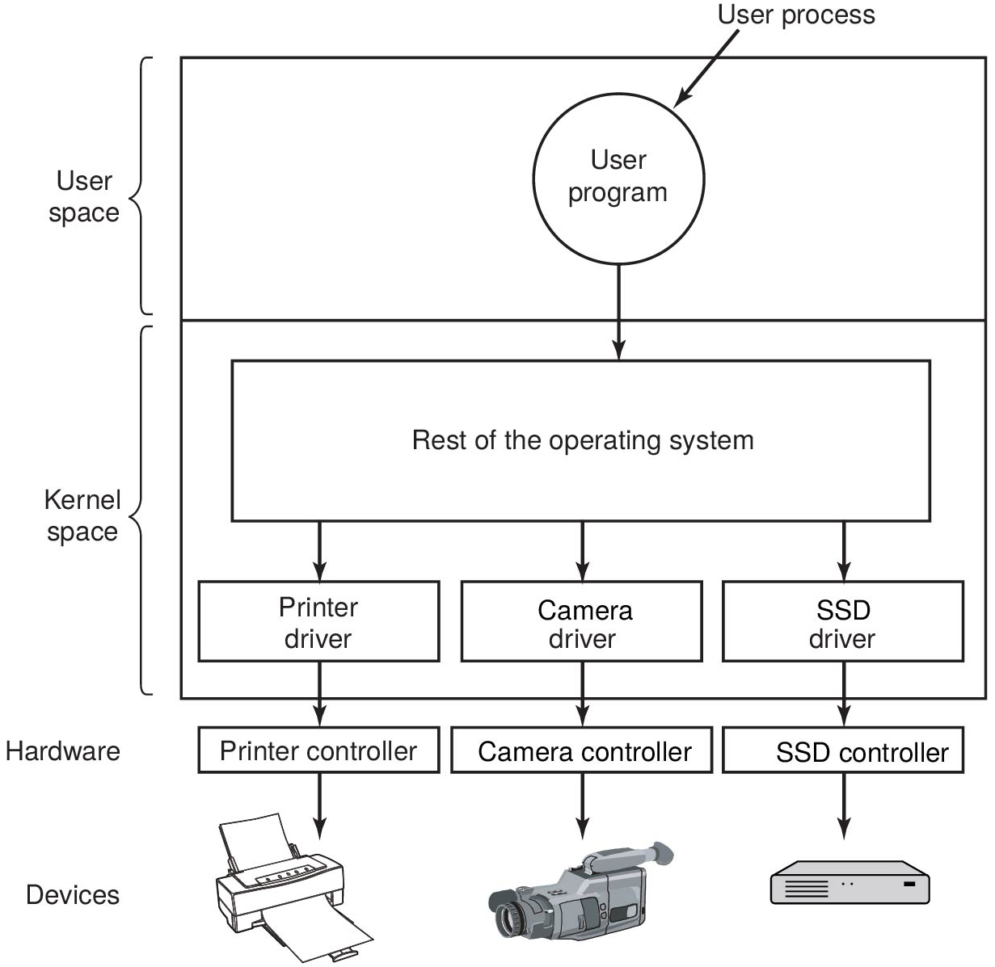
Device Drivers (2)
Figure 5.12 Logical positioning of device drivers. In reality all communication between drivers and device controllers goes over the bus.
Notes:
Long Description:
The figure shows a block divided into two segments labeled user space and kernel space. The user space segment contains a circular block labeled user program which represents user process pointed to a block labeled rest of the operating system which is given inside the kernel space segment. From the rest of the operating system block, three arrows point to three blocks labeled printer driver, camera driver, S S D driver. Again three arrows from these blocks point to another three blocks which come under the hardware part labeled printer controller, camera controller, S S D controller. These three blocks are connected to the printer, camera, and S S D devices.

Slide 42
Device-Independent I/O Software (1 of 2)
Uniform interfacing for device drivers
Buffering
Error reporting
Allocating and releasing dedicated devices
Providing a device-independent block size
Figure 5.13 Functions of the device-independent I/O software.

Slide 43
Device-Independent I/O Software (2 of 2)
Uniform interfacing for device drivers
Driver interface, naming (e.g., major/minor numbers), protection
Buffering
Necessary for both character and block devices
Error reporting
Hardware-level, driver-level, etc.
Allocating and releasing dedicated devices
e.g., Printers
Providing a device-independent block size
Unify blocks/characters across devices

Slide 44
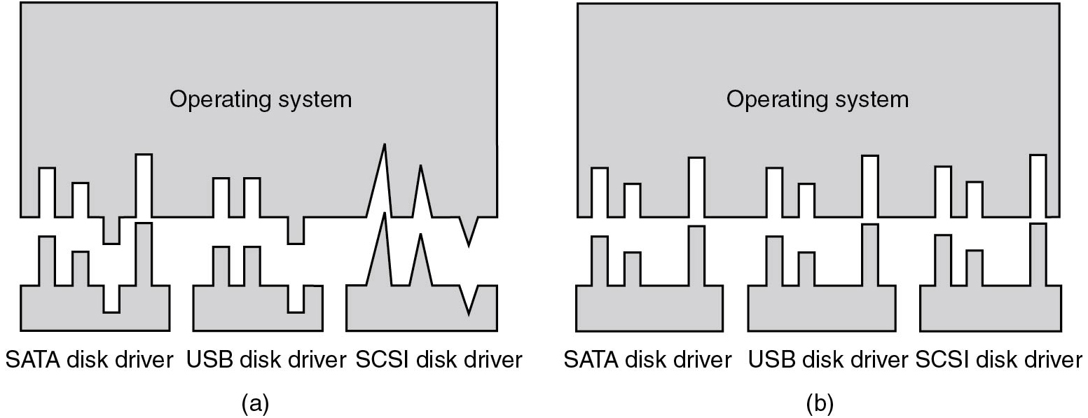
Uniform Interfacing for Device Drivers
Figure 5.14 (a) Without a standard driver interface. (b) With a standard driver interface.
Notes:
Long Description:
Figure a: It contains a block labeled operating system with its bottom part cut and separated in an irregular shape and placed below the block. The three separated parts are labeled S A T A disk driver, U S B disk driver, and S C S I disk driver.
Figure b: It contains a block labeled operating system with its bottom part cut and separated in a varying shape and placed below the block. The three parts are labeled S A T A disk driver, U S B disk driver, and S C S I disk driver.

Slide 45
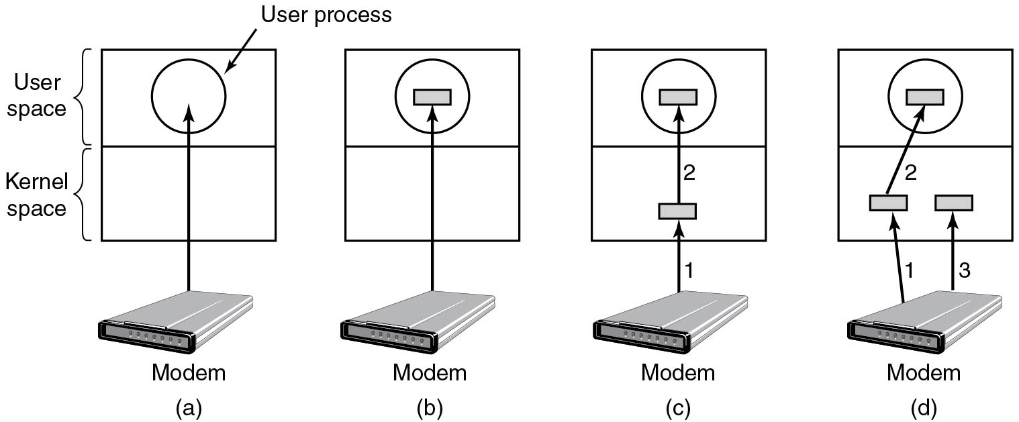
Buffering (1)
Figure 5.15 (a) Unbuffered input. (b) Buffering in user space. (c) Buffering in the kernel followed by copying to user space. (d) Double buffering in the kernel.
Notes:
Long Description:
A set of four blocks consisting of two segments labeled user space and kernel space is shown here.
Figure a: Here a modem is pointed to the user process inside the user-space given segment.
Figure b: Here a modem is pointed to the rectangular block of the user process given inside the user-space segment.
Figure c: Here an arrow labeled 1 is pointed from the modem to a block given inside the kernel space. Again an arrow labeled 2 is pointed from this block to another block of user process given inside the user space.
Figure d: Here two arrows labeled 1 and 3 are pointed from the modem to two blocks given inside the kernel space. Another arrow labeled 2 points from the first block to another block of user process given inside the user space.

Slide 46
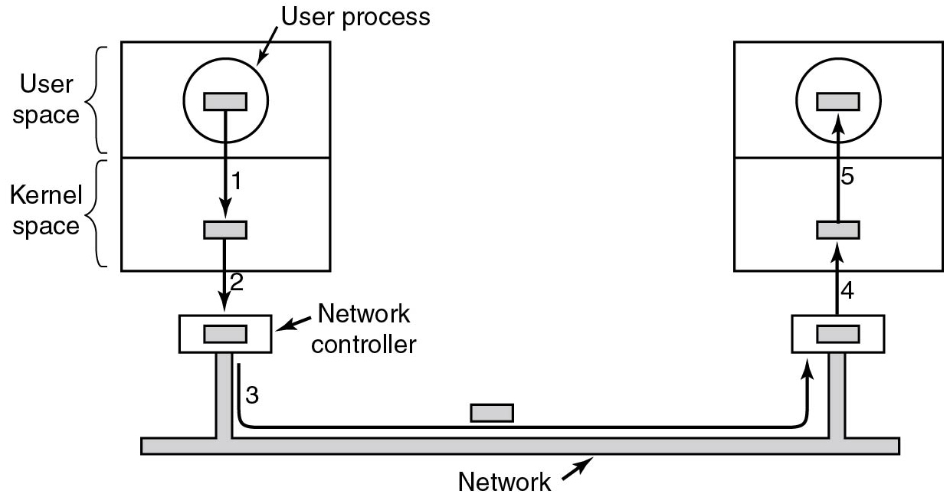
Buffering (2)
Figure 5.16 Networking may involve many copies of a packet.
Notes:
Long Description:
The figure shows two blocks consisting of two segments labeled user space and kernel space placed at two ends and connected by a network. The user space segment of the left block contains a sub-block labeled user process which is pointed to another sub-block given inside the kernel space using an arrow 1. Another arrow labeled 2 points from this block points to a block labeled network controller and it is connected to another network controller placed below the right block using an arrow labeled 3. An arrow labeled 4 points from the right network controller to a block given inside the kernel space and again arrow 5 points from this sub-block to another block given inside the user space.

Slide 47
User-Level I/O Software
Offers a uniform interface to user to access devices
C standard I/O library
fopen, fclose, fflush, fprintf, etc
Safely multiplexes access to exclusive devices
E.g. Printing spooler

Slide 48
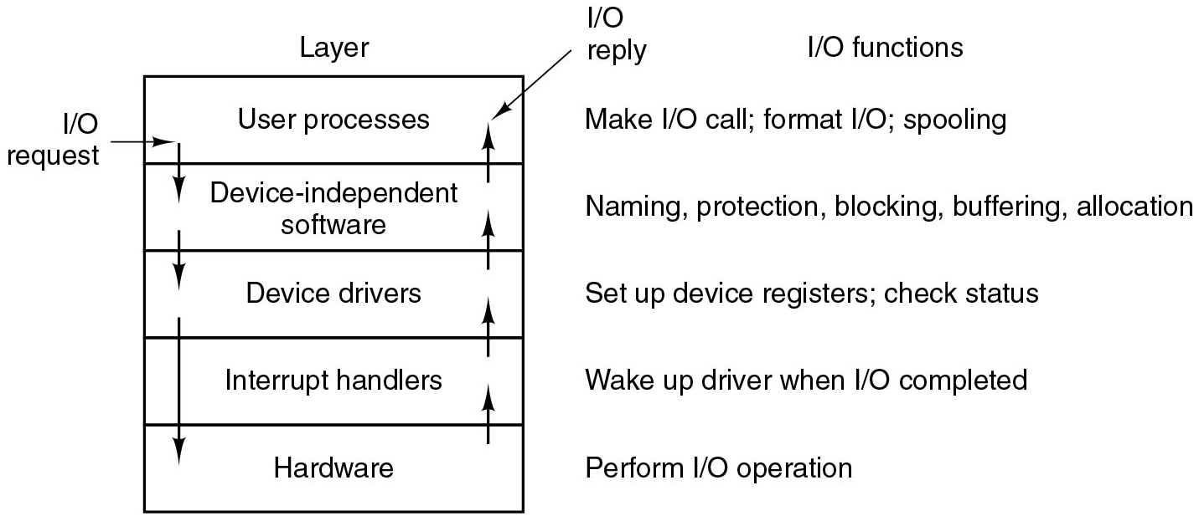
Layers of I/O Software
Figure 5.17 Layers of the I/O system and the main functions of each layer.
Notes:
Long Description:
The figure consists of a block labeled layer which is divided into five segments. The five segments are labeled from top to bottom as follows. User processes, Device-independent software, Device drivers, Interrupt handlers, and Hardware. Three arrows pointed downward starting from the first layer to the last layer sequentially are labeled I O request and another four arrows pointed upward from bottom to top layer are labeled I O reply.
The I O functions of each layer from top to bottom are labeled as follows. Layer 1: Make I O call; format I O; spooling. Layer 2: Naming, protection, blocking, buffering, allocation. Layer 3: Set up device registers; check status.
Layer 4: Wake up the driver when I O completed. Layer 5: Perform I O operation.

Slide 49
Overview (4 of 4)
Principles of I/O Hardware
Principles of I/O Software
I/O Devices

Slide 50
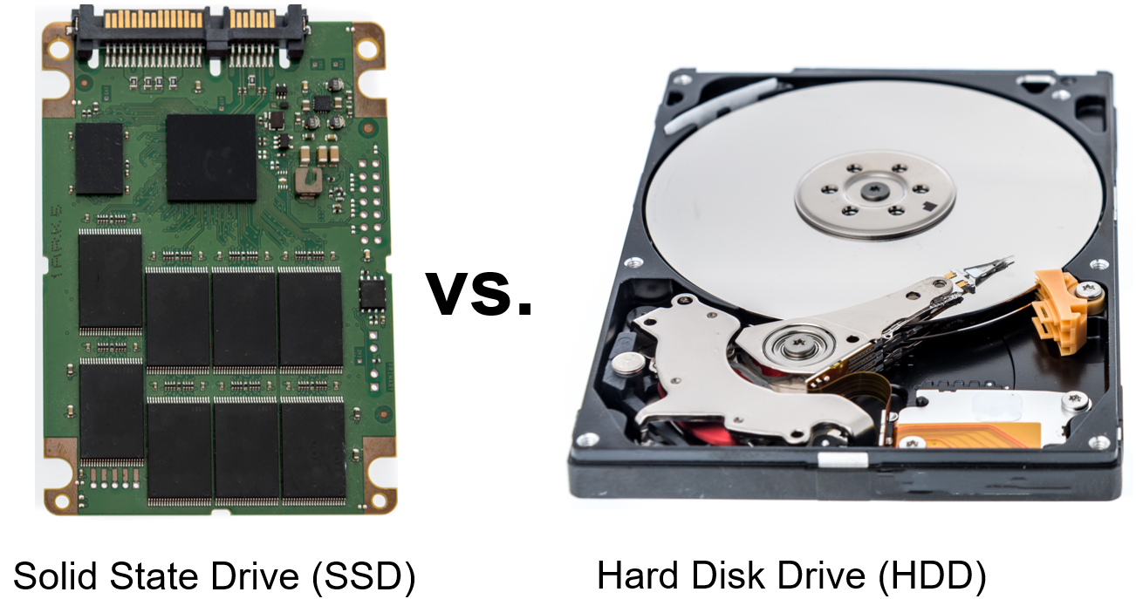
Storage Devices: S S D versus. H D D (1)
Keith Homan/Shutterstock
Notes:
Long Description:
The illustration compares a S S D and an H D D. The left illustration shows an opened S S D while the right illustration shows an opened H D D.

Slide 51


Storage Devices: S S D versus. H D D (2)
Blank | S S D | H D D
Power | A green tick mark sign. | A red cross mark.
Heat | A green tick mark sign. | A red cross mark.
Noise | A green tick mark sign. | A red cross mark.
Vibration | A green tick mark sign. | A red cross mark.
Weight | A green tick mark sign. | A red cross mark.
Durability | A green tick mark sign. | A red cross mark.
Speed | A green tick mark sign. | A red cross mark.
Cost | A red cross mark. | A green tick mark sign.
Capacity | A red cross mark. | A green tick mark sign.

Slide 52
Solid-State Drive (S S D)
D R A M or N O R/N A N D flash memory based
No mechanical parts (only controller+mem)
Can be used as part of S S H D s
N A N D flash memory
Organized in cells (S L C s or M L C s), pages, blocks
Controller can read/program at page granularity
Controller can erase at block granularity
R N D/S E Q access latency comparable
Reads more efficient than writes
Wear leveling to improve write endurance
Garbage collection to implement write operations

Slide 53
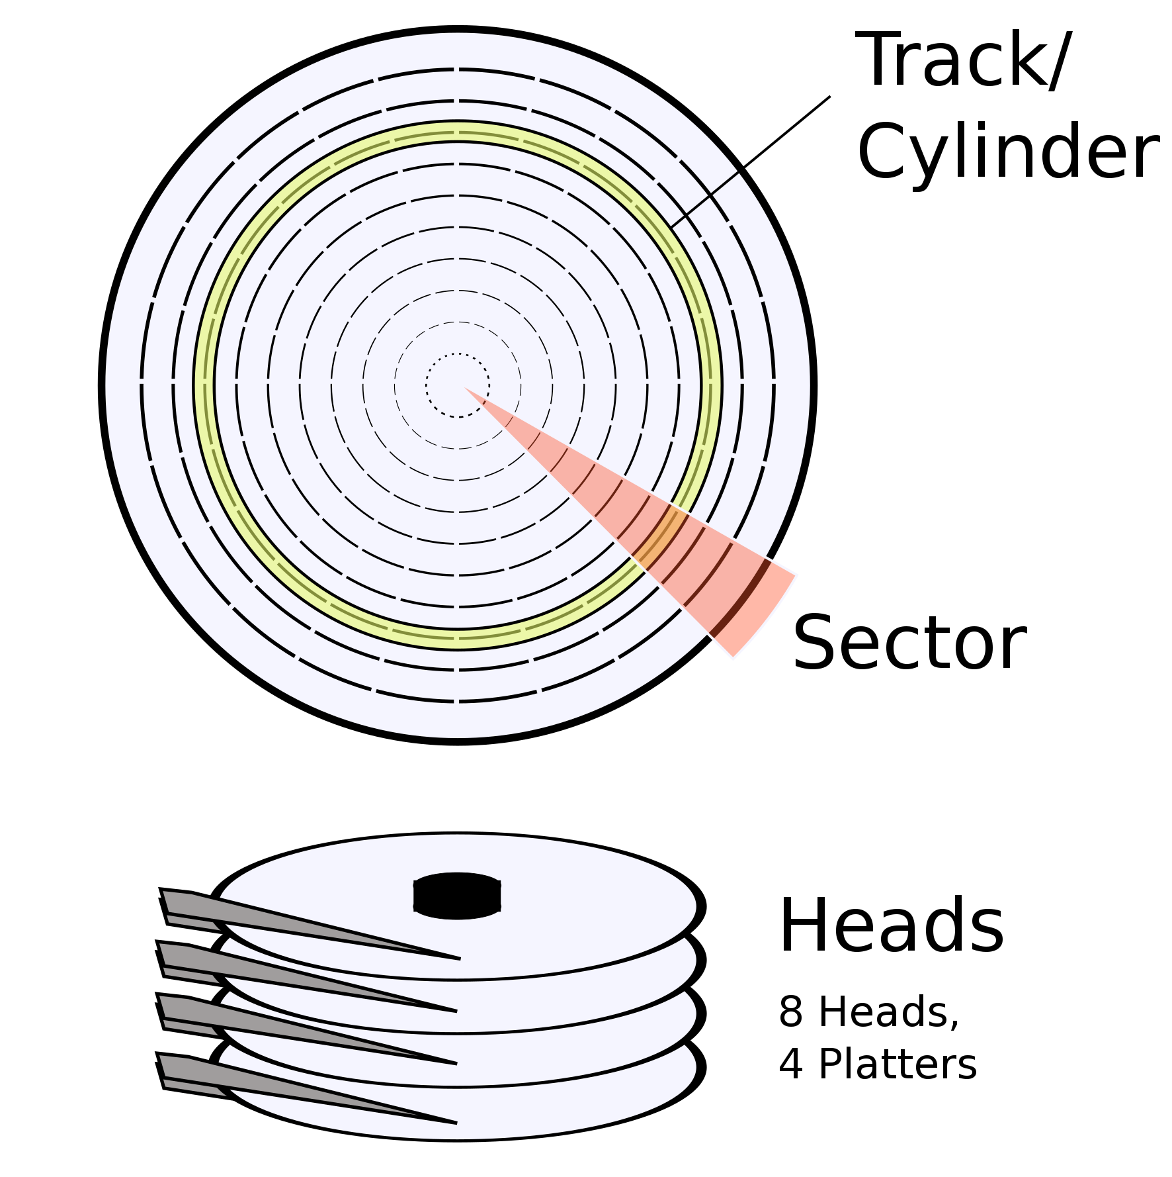
Hard Disk Drive (H D D)
Multiple platters and cylinders in a single disk with as many tracks as their heads. Each
track
N sectors
Addressing modes:
C H S (Cylinder-head-sector), virtual/physical
L B A (Logical Block Addressing), virtual
LionKimbro
Notes:
Long Description:
The Top illustration shows a diagram of multiple concentric circles. A yellow circle among the concentric circles is labeled as track slash cylinder. A red highlighted area is labeled as sector. The Bottom illustration shows heads of a hard disk drive. It is labeled as 8 heads, 4 platters.

Slide 54
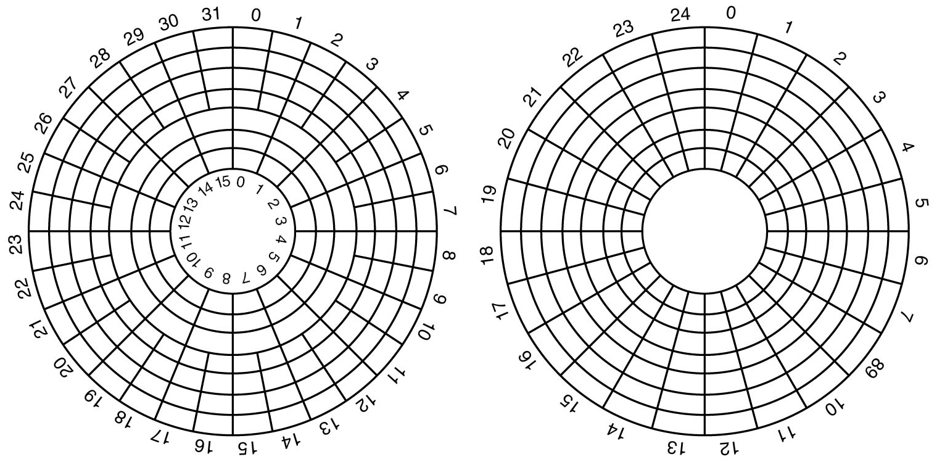
Hard Disk Geometry
Figure 5.18 (a) Physical geometry of a disk with two zones. (b) A possible virtual geometry for this disk.
Notes:
Long Description:
Figure a: The disk contains 8 rings and is divided into two zones. The outer zone contains five rings and is divided into 32 sectors labeled from 0 to 31. The inner zone contains 3 rings and is divided into 16 sectors labeled from 0 to 15.
Figure b: Here the disk contains 8 rings and is divided into 25 sectors labeled from 0 to 24.

Slide 55
Disk Formatting (1)
Figure 5.19 A disk sector.
Notes:
Long Description:
The illustration shows a rectangle divided into three sections labeled as preamble, data, and E C C from left to right.

Slide 56
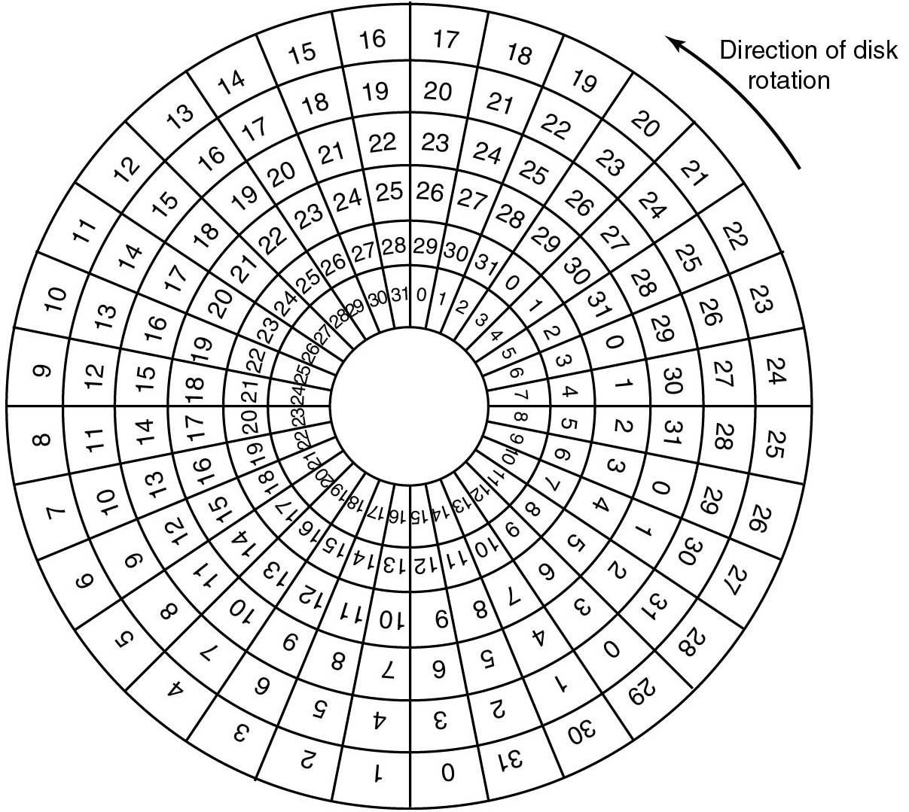
Disk Formatting (2)
Figure 5.20 An illustration of cylinder skew.
Notes:
Long Description:
The figure illustrates a disk rotating in a counterclockwise direction and consisting of seven rings. The 8 rings are divided into 32 sectors. The outer ring is labeled from 0 to 31 starting from the bottom and each inner ring is labeled 0 to 31, three sectors right of the outer ring.

Slide 57
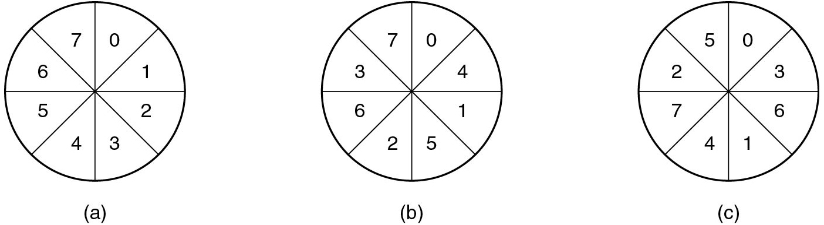
Disk Formatting (3)
Figure 5.21 (a) No interleaving. (b) Single interleaving. (c) Double interleaving.
Notes:
Long Description:
The consists of three circles which are divided into eight equal segments.
Figure a: Here the segments labeled from upper right end in clockwise direction are given as follows. 0, 1, 2, 3, 4, 5, 6, 7.
Figure b: Here the segments labeled from upper right end in clockwise direction are given as follows. 0, 4, 1, 5, 2, 6, 3, 7.
Figure c: Here the segments labeled from upper right end in clockwise direction are as follows. 0, 3, 6, 1, 4, 7, 2, 5.

Slide 58
Hard Disk: Block Read/Write Time (1)
Factors determining disk block read/write time:
Seek time
The time to move the arm to the proper cylinder
Rotational delay
The time for the sector to come under the head
Data transfer time
The time to transfer a single block
Which one dominates the read/write time?
How do we minimize it and where?

Slide 59
Hard Disk: Block Read/Write Time (2)
Factors determining disk block read/write time:
Seek time
The time to move the arm to the proper cylinder
Rotational delay
The time for the sector to come under the head
Data transfer time
The time to transfer a single block
Which one dominates the read/write time? Seek time
How do we minimize it and where? Sort requests by cylinder number

Slide 60
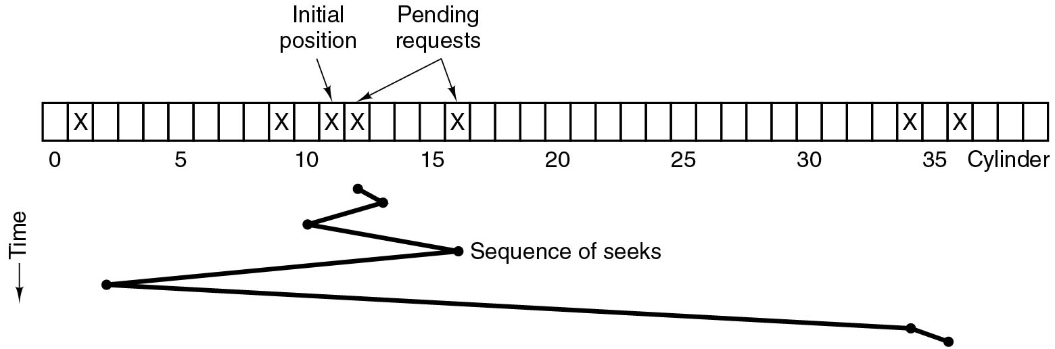
Disk Arm Scheduling Algorithms (1)
Figure 5.22 Shortest Seek First (S S F) disk scheduling algorithm.
Notes:
Long Description:
The figure shows a block labeled cylinder consisting of 40 columns. Columns 1, 9, 11, 12, 16, 34, and 36 are marked X. Column 11 is labeled initial position, and columns 12 and 16 are labeled pending requests. A zig-zag line labeled sequence of seeks is plotted below the block whose vertical axis is labeled time. It starts below column 12, goes down, and ends at the lower right end.

Slide 61
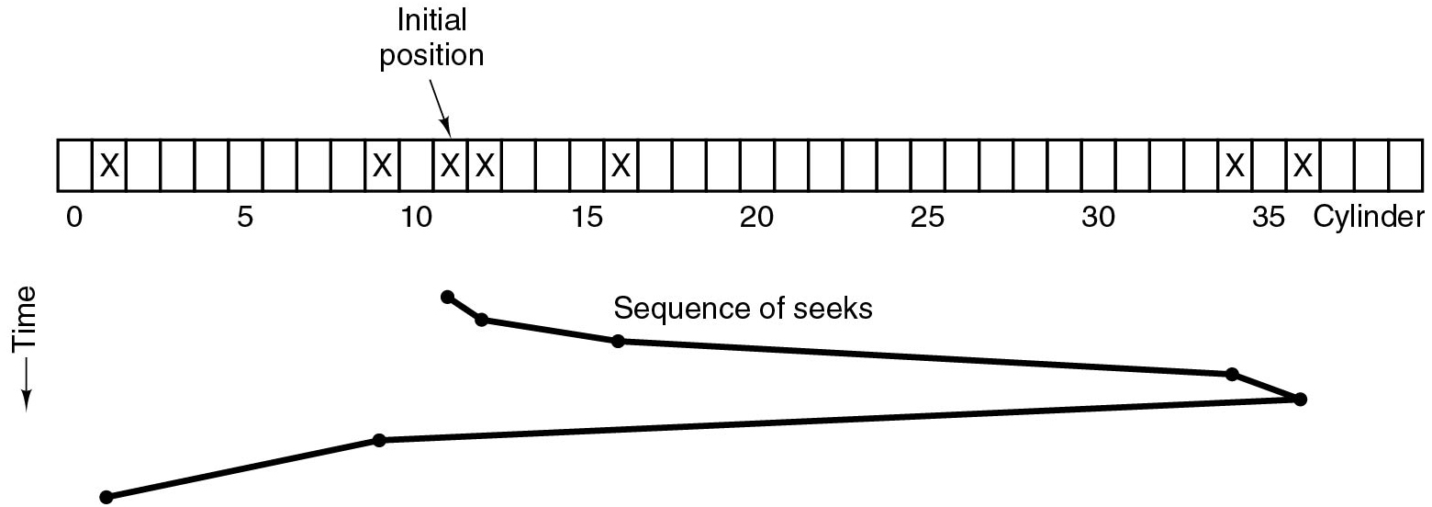
Disk Arm Scheduling Algorithms (2)
Figure 5.23 The elevator algorithm for scheduling disk requests.
Notes:
Long Description:
The figure shows a block labeled cylinder consisting of 40 columns. Columns 1, 9, 11, 12, 16, 34, and 36 are marked X. Column 11 is labeled initial position. A zig-zag line labeled sequence of seeks is plotted below the block whose vertical axis is labeled time. It starts below column 11, moves toward the lower right until column 36, then moves toward the lower left and ends below column 1.

Slide 62
Hard Disk: Error Handling
Programming Errors
e.g., request for nonexistent sector
Transient Errors
e.g., caused by dust on the head
Permanent Errors
e.g., disk block physically damaged
Seek Errors
e.g., the arm was sent to cylinder 6 but it went to 7
Controller Errors
e.g., controller refuses to accept commands

Slide 63
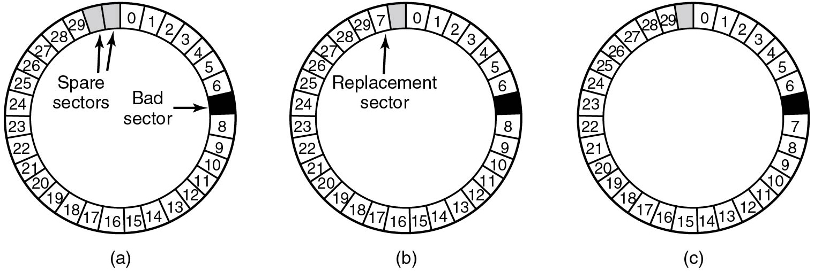
Hard Disk: Bad Sector Remapping
Figure 5.24 (a) A disk track with a bad sector. (b) Substituting a spare for the bad sector. (c) Shifting all the sectors to bypass the bad one.
Notes:
Long Description:
The figure shows three disks divided into 31 segments.
Figure a: The segments are labeled 0 to 29 from the top in a clockwise direction. The seventh segment is left empty and shaded in dark and labeled bad sector. Segments 30 and 31 are also left empty and shaded in a light color and labeled space sector.
Figure b: The segments are labeled 0 to 29 from the top in a clockwise direction. The seventh segment is left empty and shaded in dark. Segments 30 is labeled 7 and segment 31 is left empty and shaded in a light color.
Figure c: The segments are labeled from the top in a clockwise direction as follows, 0 to 6, then blank, 7 to 29, then blank. The first blank segment is shaded in dark color and the second blank segment is shaded in a light color.

Slide 64
Clock Hardware
Two types:
Simple clocks deliver hardware interrupts for each voltage cycle of the power supply (i.e., every 20 or 16.7 m s)
Advanced programmable clocks that have own crystal oscillator that decrements a counter in a register.
If counter hits zero
H W interrupt
H W also provides “counters” S W can read as needed

Slide 65
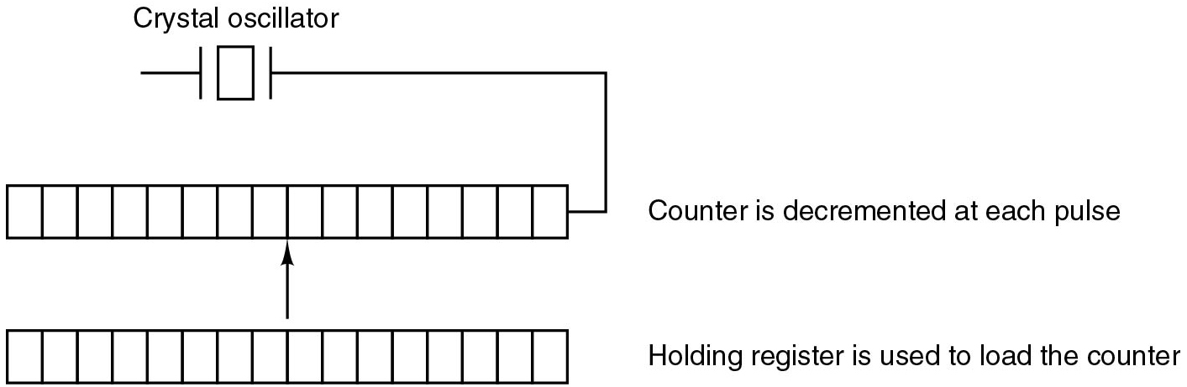
Advanced Programmable Clock Example
Figure 5.27. A programmable clock.
Oscillator has a frequency of 1 M H z
The register is 16 bit
Hence, we can set the timer between 1 and
Notes:
Long Description:
The figure shows two horizontal blocks consisting of 16 segments placed one below the other and connected by an arrow pointing from the bottom block to the top block. A crystal oscillator is connected from the right end of the top block.

Slide 66
Clock Software (1)
Typical duties of a clock driver:
Maintaining the time of day
System boot time (backup clock) + uptime (ticks)
Preventing processes from running longer than allowed
Decrement current process' quantum at each tick
Accounting for C P U usage
Increment current process’ c p u time at each tick

Slide 67
Clock Software (2)
Typical duties of a clock driver:
Handling alarm system call from user processes
Decrement alarm counter at each tick
Providing watchdog timers for parts of system itself
Generate sys notifications for synchronous alarms
Profiling, monitoring, statistics gathering
Increment specific counters at each tick

Slide 68
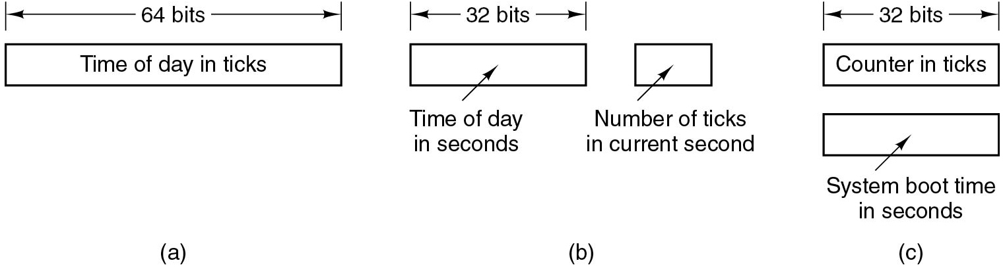
Clock Software (3)
Figure 5.28 Three ways to maintain the time of day.
Notes:
Long Description:
Figure a: It consists of a block labeled time of day in ticks. The number of bits is given 64.
Figure b: It consists of two blocks labeled time of day in seconds and number of ticks in the current second. The first block has 32 bits.
Figure c: It consists of two blocks labeled counter in ticks and system boot time in seconds. Each block is of 32 bits.

Slide 69
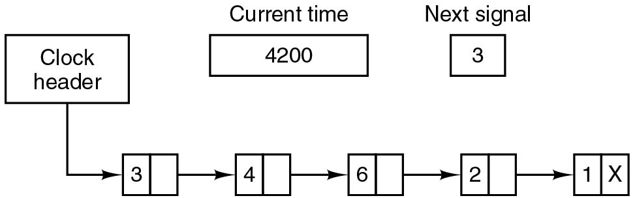
Clock Software (4)
Figure 5.29 Simulating multiple timers with a single clock.
Notes:
Long Description:
The figure shows four blocks containing two columns arranged sequentially from left to right are given as follows. First block: 3, blank. Second block: 4, blank. Third block: 6, blank. Fourth block: 2, blank. Fifth block: 1, X. A clock header is given to the first block. A block labeled current time which contains 4200 and another block labeled next signal containing 3 is placed at the top.

Slide 70
Soft Timers
Soft timers stand or fall with the rate at which kernel entries are made for other reasons. These reasons include:
System calls
T L B misses
Page faults
I/O interrupts
The C P U going idle

Slide 71
Keyboard Software
Character | POSIX name | Comment
CTRL-H | ERASE | Backspace one character
CTRL-U | KILL | Erase entire line being typed
CTRL-V | LNEXT | Interpret next character literally
CTRL-S | STOP | Stop output
CTRL-Q | START | Start output
DEL | I N T R | Interrupt process
CTRL-\ | QUIT | Force core dump
CTRL-D | E O F | End of file
CTRL-M | C R | Carriage return (unchangeable)
CTRL-J | N L | Linefeed (unchangeable)
Figure 5.31 Characters that are handled specially in canonical mode.

Slide 72
Output Software – Text Windows (1)
Escape Sequence | Meaning
E S C [n A | Move up n lines
E S C [n B | Move down n lines
E S C [n C | Move right n spaces
E S C [n D | Move left n spaces
E S C [m ; n H | Move cursor to (m,n)
E S C [s J | Clear screen from cursor (0 to end, 1 1from start, 2 all)
E S C [s K | Clear line from cursor (0 to end, 1 1from start, 2 all)
Figure 5.32 The A N S I escape sequences accepted by the terminal driver on output. E S C denotes the A S C I I escape character (0x1B), and n, m, and s are optional numeric parameters.

Slide 73
Output Software – Text Windows (2)
Escape Sequence | Meaning
E S C [n L | Insert n lines at cursor
E S C [n M | Delete n lines at cursor
E S C [n P | Delete n chars at cursor
E S C [n @ | Insert n chars at cursor
E S C [n m | Enable rendition n (0=normal, 4=bold, 5=blinking, 7=reverse)
E S C M | Scroll the screen backward if the cursor is on the top line
Figure 5.32 The A N S I escape sequences accepted by the terminal driver on output. E S C denotes the A S C I I escape character (0x1B), and n, m, and s are optional numeric parameters.

Slide 74
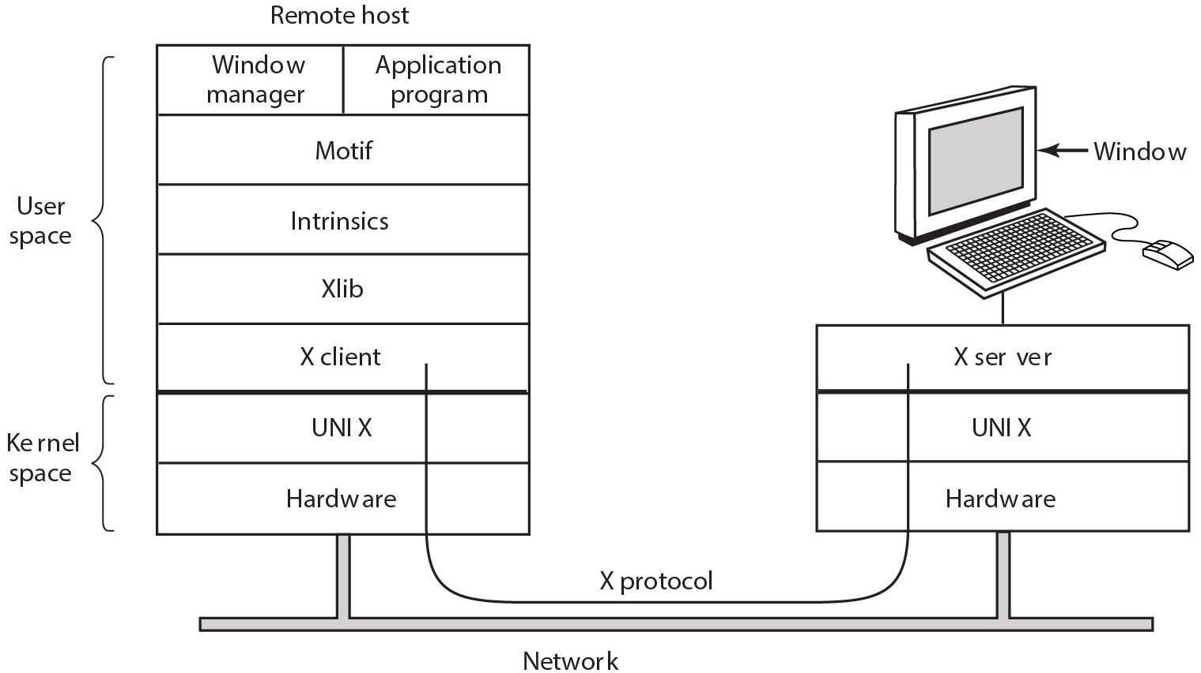
The X Window System (1)
Figure 5.33 Clients and servers in the M.I.T. X Window System.
Notes:
Long Description:
The figure shows a block labeled remote host which consists of seven rows. The first five rows are labeled user space and the remaining two rows are labeled kernel space. The first row consists of two columns labeled window manager, application program. The remaining rows are labeled from top to bottom as follows. Motiff, Intrinsic, Xlib, X client, UNIX, hardware. Another block is given next to the remote host block which contains three rows labeled X server, UNIX, and hardware. This block is connected to a computer that has a window. The two blocks are connected by a network. The X client of the first block is connected to the X server of the second block.

Slide 75
The X Window System (2)
Types of messages between client and server:
Drawing commands from program to workstation.
Replies by workstation to program queries.
Keyboard, mouse, and other event announcements.
Error messages.

Slide 76
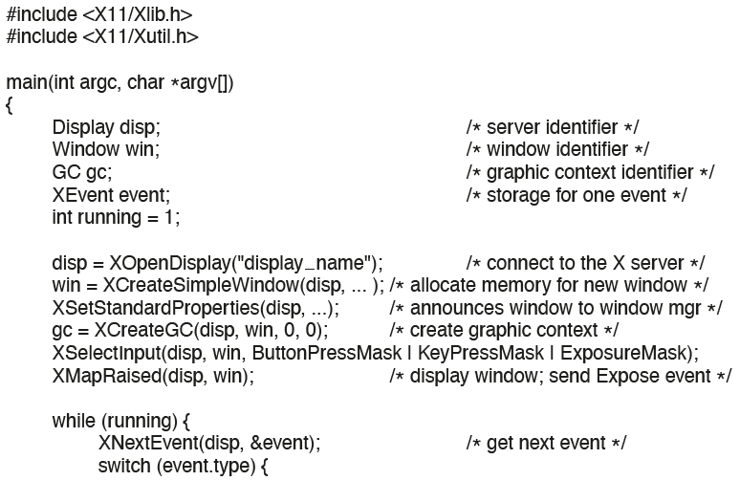
The X Window System (3)
Figure 5.34 A skeleton of an X Window application program.
Notes:
Long Description:
The code from top to bottom is as follows.
hash include left angle bracket X 1 1 X l i b dot h right angle bracket
hash include left angle bracket X 1 1 X u t i l dot h right angle bracket
main left parenthesis int arg c comma char asterisk arg v left square bracket right square bracket right parenthesis
left brace
Display disp semicolon forward slash asterisk server identifier asterisk forward slash
Window win semicolon forward slash asterisk window identifier asterisk forward slash
G C g c semicolon forward slash asterisk graphic context identifier asterisk forward slash
XEvent event semicolon forward slash asterisk storage for one event identifier asterisk forward slash
int running equals 1 semicolon
disp equals XOpenDisplay left parenthesis double quotation display underscore name double quotation right parenthesis semicolon forward slash asterisk connect to the X server asterisk forward slash
win equals XCreateSimpleWindow left parenthesis disp comma ellipsis right parenthesis semicolon forward slash asterisk allocate memory for new window asterisk forward slash
XSetStandardProperties left parenthesis disp comma ellipsis right parenthesis semicolon forward slash asterisk announces window to window m g r asterisk forward slash
g c equals XCreate G C left parenthesis disp, win, 0, 0 right parenthesis semicolon forward slash asterisk create graphic context asterisk forward slash
XSelectInput left parenthesis disp comma, win comma, ButtonPressMask vertical bar KeyPressMask vertical bar ExposureMask right parenthesis semicolon
XMapRaised left parenthesis disp win right parenthesis semicolon forward slash asterisk display window semicolon send Expose event asterisk forward slash
while left parenthesis running right parenthesis left brace
XNextEvent left parenthesis disp comma, ampersand event right parenthesis semicolon forward slash asterisk get next event asterisk forward slash
switch left parenthesis event dot type right parenthesis left brace

Slide 77
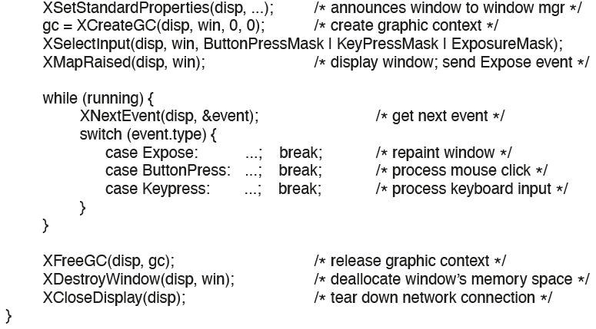
The X Window System (4)
Figure 5.34 A skeleton of an X Window application program.
Notes:
Long Description:
The code from top to bottom is as follows.
XSetStandardProperties left parenthesis disp comma ellipsis right parenthesis semicolon forward slash asterisk announces window to window m g r asterisk forward slash
g c equals XCreate G C left parenthesis disp, win, 0, 0 right parenthesis semicolon forward slash asterisk create graphic context asterisk forward slash
XSelectInput left parenthesis disp comma, win comma, ButtonPressMask vertical bar KeyPressMask vertical bar ExposureMask right parenthesis semicolon
XMapRaised left parenthesis disp win right parenthesis semicolon forward slash asterisk display window semicolon send Expose event asterisk forward slash
while left parenthesis running right parenthesis left brace
XNextEvent left parenthesis disp comma, ampersand event right parenthesis semicolon forward slash asterisk get next event asterisk forward slash
switch left parenthesis event dot type right parenthesis left brace
case Expose colon ellipsis semicolon break semicolon forward slash asterisk repaint window asterisk forward slash
case ButtonPress colon ellipsis semicolon break semicolon forward slash asterisk process mouse click asterisk forward slash
case Keypress colon ellipsis semicolon break semicolon forward slash asterisk process keyboard input asterisk forward slash
right brace
right brace
XFree G C left parenthesis disp comma g c right parenthesis semicolon forward slash asterisk release graphic context asterisk forward slash
XDestroyWindow left parenthesis disp comma win right parenthesis semicolon forward slash asterisk deallocate window's memory space asterisk forward slash
XCloseDisplay left parenthesis disp right parenthesis semicolon forward slash asterisk tear down network connection asterisk forward slash
right brace

Slide 78
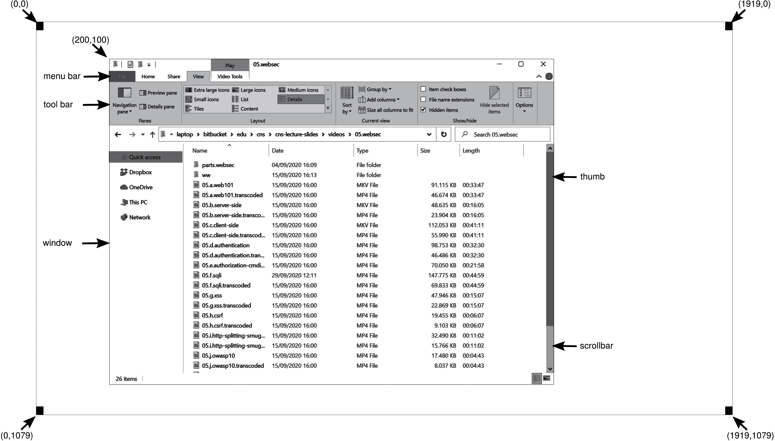
Graphical User Interfaces (1)
Figure 5.35 A sample window located at (200, 100) on an X G A display.

Slide 79
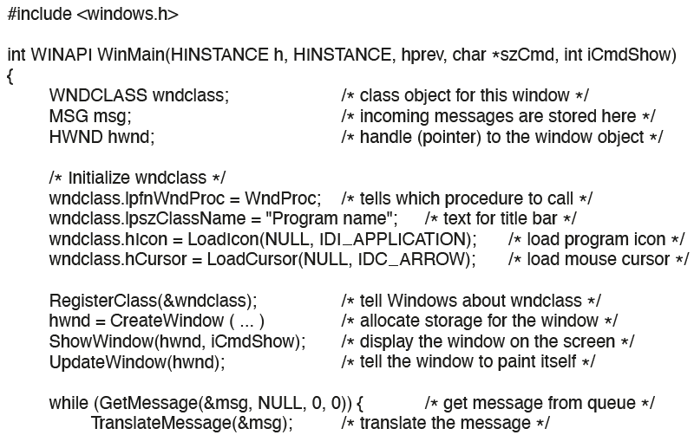
Graphical User Interfaces (2)
Figure 5.36 A skeleton of a Windows main program.
Notes:
Long Description:
The code from top to bottom is as follows.
hash include left angle bracket windows dot h right angle bracket
int W I N A P I WinMain left parenthesis HINSTANCE h comma HINSTANCE comma h p r e v comma char asterisk s z C m d comma int i C m d comma int iCmdShow right parenthesis
left brace
W N D C L A S S w n d class semicolon forward slash asterisk class object for this window asterisk forward slash
M S G m s g semicolon forward slash asterisk incoming messages are stored here asterisk forward slash
H W N D h w n d semicolon forward slash asterisk handle left parenthesis pointer right parenthesis to the window object asterisk forward slash
forward slash asterisk Initialize wndclass asterisk forward slash
wndclass dot lpfnWndProc equals WndProc semicolon forward slash asterisk tells which procedure to call asterisk forward slash
wndclass dot lpszClassName equals double quotation Program name double quotation semicolon forward slash asterisk Text for title bar asterisk forward slash
wndclass dot hlcon equals LoadIcon left parenthesis NULL comma IDI underscore APPLICATION right parenthesis semicolon forward slash asterisk load program icon asterisk forward slash
wndclass dot hCursor equals LoadICursor left parenthesis NULL comma IDC underscore ARROW right parenthesis semicolon forward slash asterisk load mouse cursor asterisk forward slash
RegisterClass left parenthesis ampersand wndclass right parenthesis semicolon forward slash asterisk tell Windows about wndclass asterisk forward slash
hwnd equals CreateWindow left parenthesis ellipsis right parenthesis forward slash asterisk allocate storage for the window asterisk forward slash
ShowWindow left parenthesis hwnd comma iCmdShow right parenthesis semicolon forward slash asterisk display the window on the screen asterisk forward slash
UpdateWindow left parenthesis hwnd right parenthesis semicolon forward slash asterisk tell the window to paint itself asterisk forward slash
while left parenthesis GetMessage left parenthesis ampersand m s g comma NULL comma 0 comma 0 right parenthesis right parenthesis left brace forward slash asterisk get message from queue asterisk forward slash
TranslateMessage left parenthesis ampersand m s g right parenthesis semicolon forward slash asterisk translate the message asterisk forward slash

Slide 80
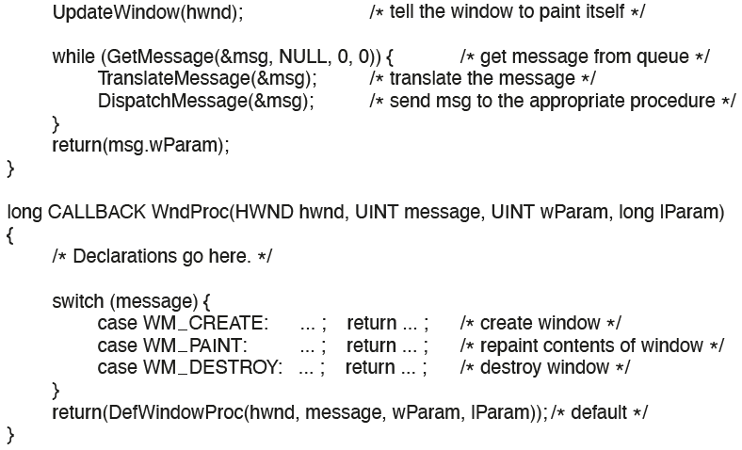
Graphical User Interfaces (3)
Figure 5.36 A skeleton of a Windows main program.
Notes:
Long Description:
The code from top to bottom is as follows.
UpdateWindow left parenthesis hwnd right parenthesis semicolon forward slash asterisk tell the window to paint itself asterisk forward slash
while left parenthesis GetMessage left parenthesis ampersand m s g comma NULL comma 0 comma 0 right parenthesis right parenthesis left brace forward slash asterisk get message from queue asterisk forward slash
TranslateMessage left parenthesis ampersand m s g right parenthesis semicolon forward slash asterisk translate the message asterisk forward slash
DispatchMessage left parenthesis ampersand m s g right parenthesis semicolon forward slash asterisk send msg to the appropriate procedure asterisk forward slash
right brace
long CALLBACK WindProc left parenthesis H W N D hwnd comma U I N T message comma U I N T wParam comma long lParam right parenthesis
right brace
return left parenthesis msg dot wParam right parenthesis semicolon
forward slash asterisk Declarations go here asterisk forward slash
switch left parenthesis message right parenthesis left brace
case WM underscore CREATE colon ellipsis semicolon return ellipsis semicolon forward asterisk create window asterisk forward slash
case WM underscore PAINT colon ellipsis semicolon return ellipsis semicolon forward asterisk repaint contents of window asterisk forward slash
case WM underscore DESTROY colon ellipsis semicolon return ellipsis semicolon forward asterisk destroy window asterisk forward slash
right brace
return left parenthesis DefWindowProc left parenthesis hwnd comma message comma wParam comma IParam right parenthesis right parenthesis semicolon forward slash asterisk default asterisk forward slash
right brace

Slide 81
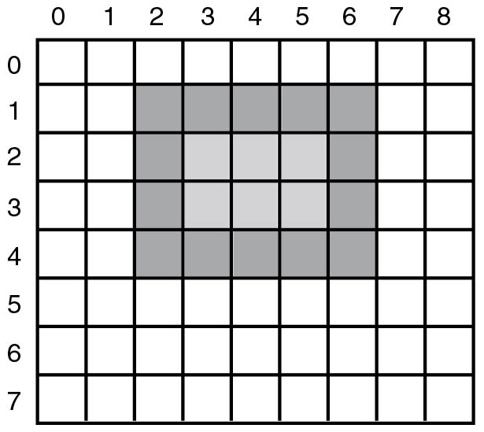
Graphical User Interfaces (4)
Figure 5.37 An example rectangle drawn using Rectangle. Each box represents one pixel.
Notes:
Long Description:
The figure illustrates a rectangle containing nine columns and eight rows. The column is numbered from 0 to 8 and rows are numbered from 0 to 7. Columns 2 to 7 in the second row and fourth row are shaded in dark. Row 2, 3 of column 2, and column 6 are also shaded in dark. Columns 3, 4, and 5 of the second and third row are shaded in a light color.

Slide 82
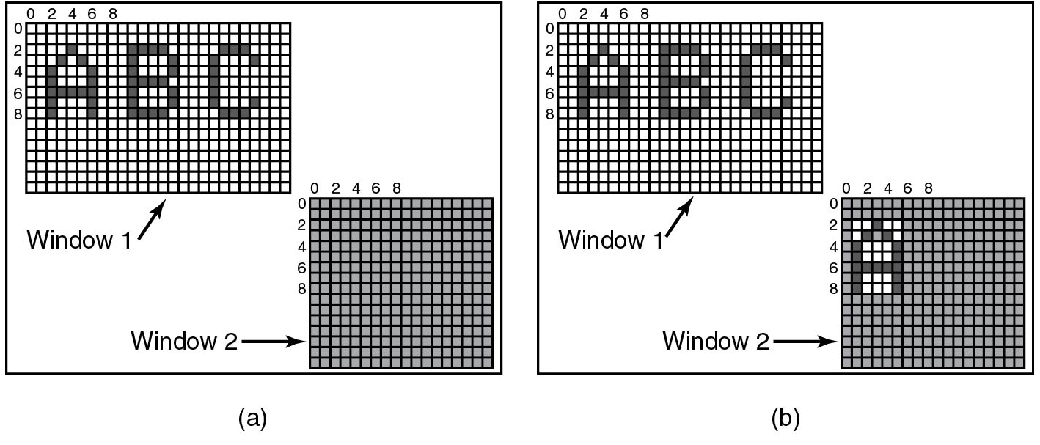
Bitmaps
Figure 5.38 Copying bitmaps using BitBlt. (a) Before. (b) After.
Notes:
Long Description:
Part a: Window 1 containing 27 columns and 16 rows is shown here. The columns 0 to 8, and rows 0 to 8 are marked on the window. The letters A B C is written on the window screen. The second window is labeled window 2 which is empty and contains 16 rows and 16 columns.
Part b: Window 1 containing 27 columns and 16 rows is shown here. The columns 0 to 8, and rows 0 to 8 are marked on the window. The letters A B C is written on the window screen. The second window is labeled window 2 and contains 16 rows and 16 columns. The letter A is written on it.

Slide 83
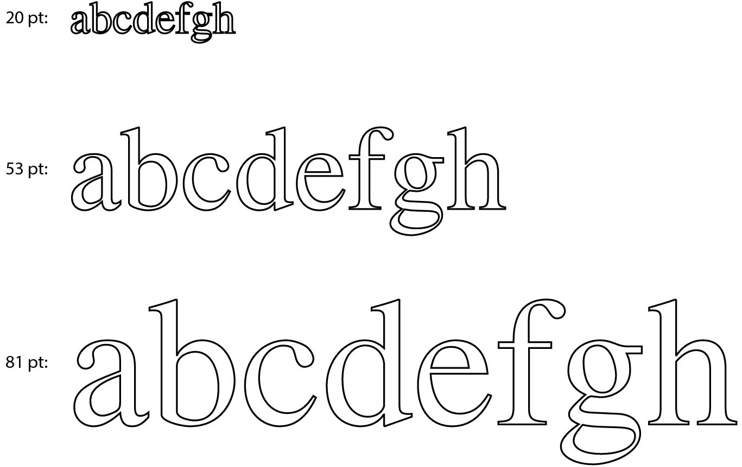
Fonts
Figure 5.39 Some examples of character outlines at different point sizes.

Slide 84
Power Consumption
Device | Li et al. (1994) | Lorch and Smith (1998)
Display | 68% | 39%
C P U | 12% | 18%
Hard Disk | 20% | 12%
Modem | Blank | 6%
Sound | Blank | 2%
Memory | 0.5% | 1%
Other | Blank | 22%
Power consumption of various parts of a notebook computer.

Slide 85
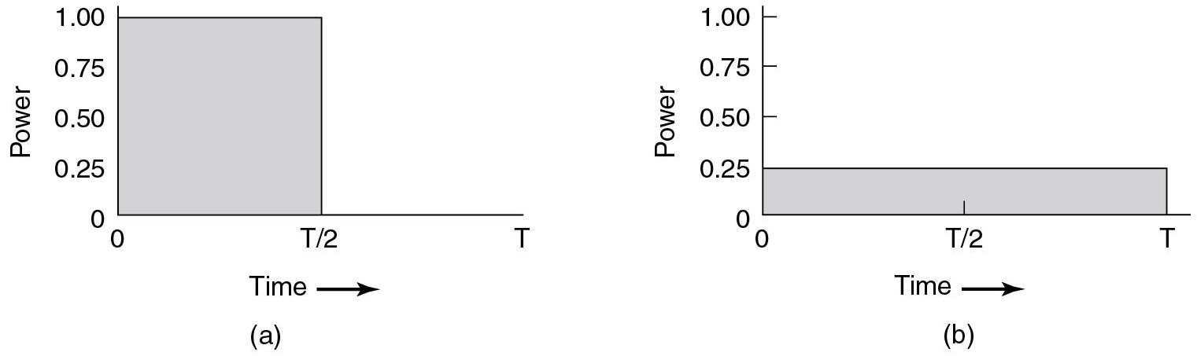
Speed versus. Power Consumption
Figure 5.40 (a) Running at full clock speed. (b) Cutting the voltage by two cuts the clock speed by two and the power consumption by four.
Notes:
Long Description:
The horizontal axis is labeled time and ranges from 0 to T in increments of T by 2 units. The vertical axis is labeled power and ranges from 0 to 1.00 in increments of 0.25 units.
Figure a: The rectangular curve starts at (0, 1.00), moves toward the right until (T by 2, 1.00), then drops downward and ends at (T by 2, 0). The area inside the curve is shaded.
Figure b: The rectangular curve starts at (0, 0.25), moves toward the right until (T, 0.25), then drops downward and ends at (T, 0). The area under the curve is shaded.

Slide 86
C-States in Modern Processors
State | Name | Meaning
C sub 0 | Active | C P U executes instructions.
C sub 1 | Auto Halt | C P U’s core clock off , other components (e.g., bus interface and interrupt controller still run at full speed so processor can return to execution almost immediately.
C sub 2 | Stop Clock | Core + bus clocks are off, but C P U maintains software-visible state.
C sub 3 | Deep Sleep | Even the clock generator is off. C P U flushes internal caches. No snooping/cache coherence.
C sub 4 | Deeper Sleep | Brilliant name for a state where the C P U voltage is reduced also.
C sub n | ellipsis | (More C-states are possible.)
Figure 5.41 Example C-States in modern processors (based on Intel terminology). As these states are model specific, you may well find that they are different for the C P U inside your own computer.

Slide 87

Copyright
This work is protected by United States copyright laws and is provided solely for the use of instructors in teaching their courses and assessing student learning. Dissemination or sale of any part of this work (including on the World Wide Web) will destroy the integrity of the work and is not permitted. The work and materials from it should never be made available to students except by instructors using the accompanying text in their classes. All recipients of this work are expected to abide by these restrictions and to honor the intended pedagogical purposes and the needs of other instructors who rely on these materials.

